Slide 1
Bus Garage – PEMB Package and Shell Proposal
Playgrounds - Proposal
October 17th, 2022
Park Rapids Additions and Renovations
PARK RAPIDS PUBLIC SCHOOLS

Slide 2
Cooperative Purchasing
Service Cooperatives are public, nonprofit membership-based organizations
dedicated to providing services that help make members successful
The Cooperatives solicit their vendors, prior to the purchase, via a competitive
solicitation process, to assure the lowest cost to the end customer
MN Statute 123A.21 / 471.345 Subdivision 15 enables schools to purchase through
cooperative purchasing organizations
Bus Garage purchase through Sourcewell
Playground purchase through NW Service Cooperative
Park Rapids Additions and Renovations

Slide 3
Metal Building State Requirements
State requires the pre-engineered metal building drawings/design at the time of
plan submission for plan review
Requires partnership with a PEMB manufacturer prior to design completion
NorSon is a Nucor supplier (PEMB supplier)
Allows for partnership and design collaboration with the supplier/erector
prior to plan submission and bidding
Park Rapids Additions and Renovations

Slide 4
Bus Garage
We obtained a quote from NorSon to supply and erect the Pre-Engineered Metal
Building for the bus garage
NorSon is a Sourcewell vendor, and this is a Cooperative Purchase
Estimate amount is $1,255,800.00 – Quote amount is $1,243,909.36
Park Rapids Additions and Renovations

Slide 5
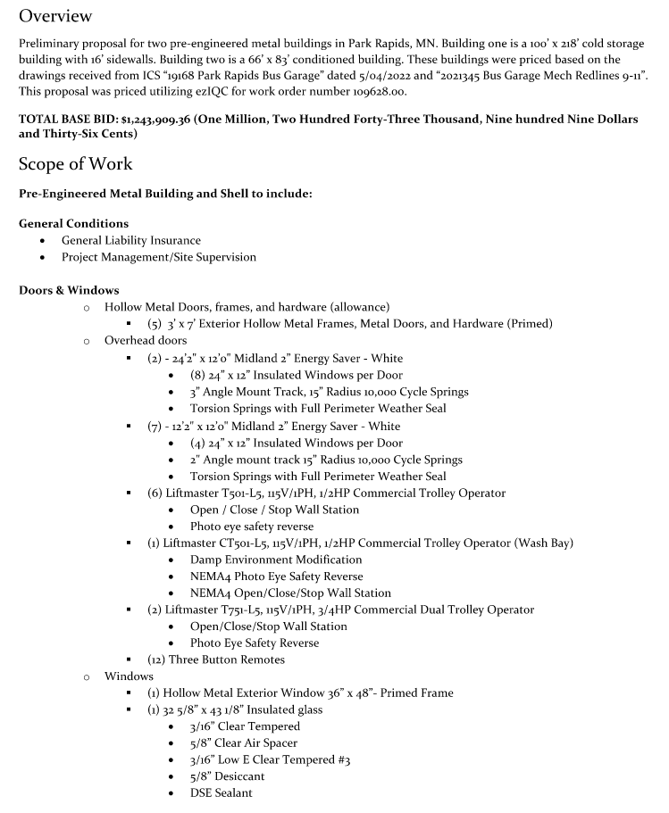
Proposal
Park Rapids Additions and Renovations

Slide 6
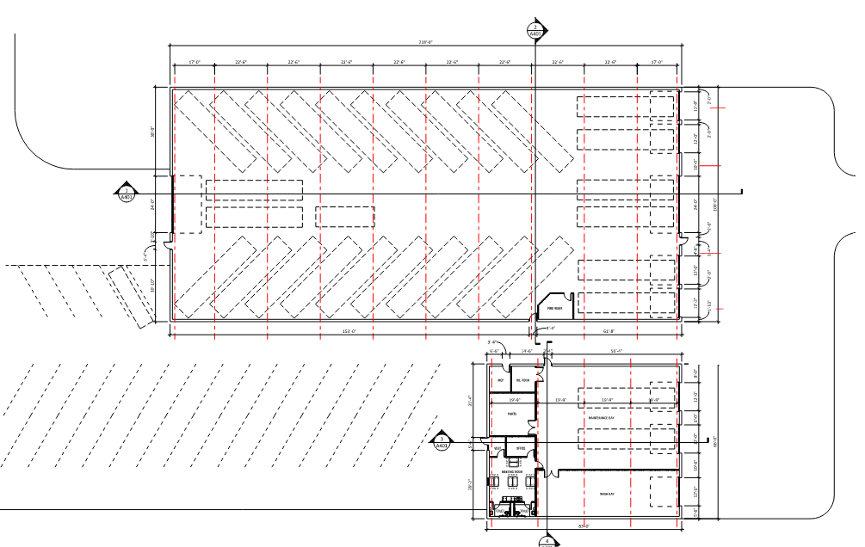
Bus Garage – Plans
Park Rapids Additions and Renovations

Slide 7
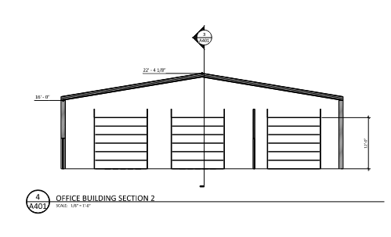
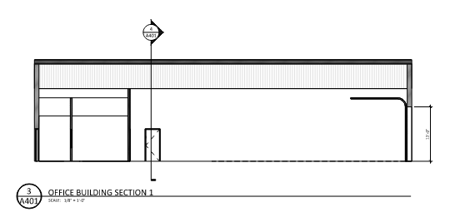
Bus Garage – Plans
Park Rapids Additions and Renovations

Slide 8
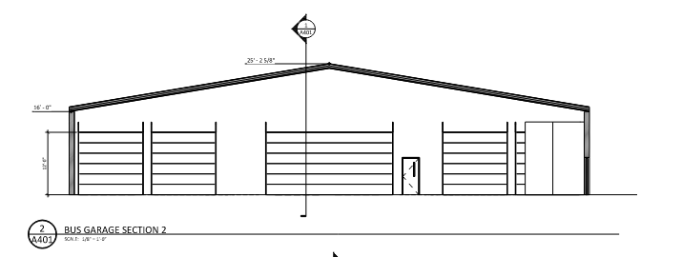
Bus Garage – Plans
Park Rapids Additions and Renovations

Slide 9
Playgrounds
We obtained a design and a proposal from Midwest Playgrounds/Northern Playgrounds
Midwest/Northern is a NW Service Co-Op vendor and this is a Cooperative Purchase
Our budget is $400,000 and the proposal amount is $395,385
Entering into this agreement will assure we complete playgrounds next summer
Park Rapids Additions and Renovations

Slide 10
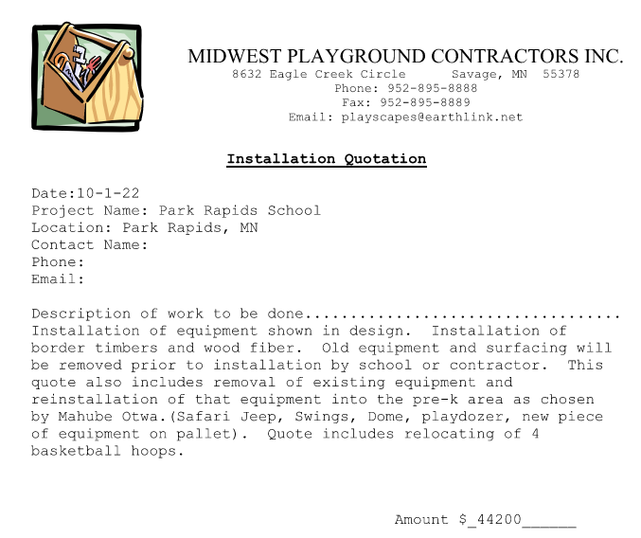
Proposal
Park Rapids Additions and Renovations

Slide 11
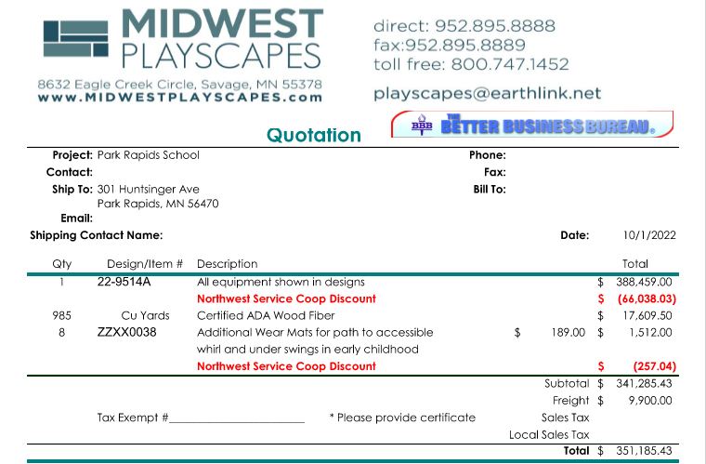
Proposal
Park Rapids Additions and Renovations

Slide 12
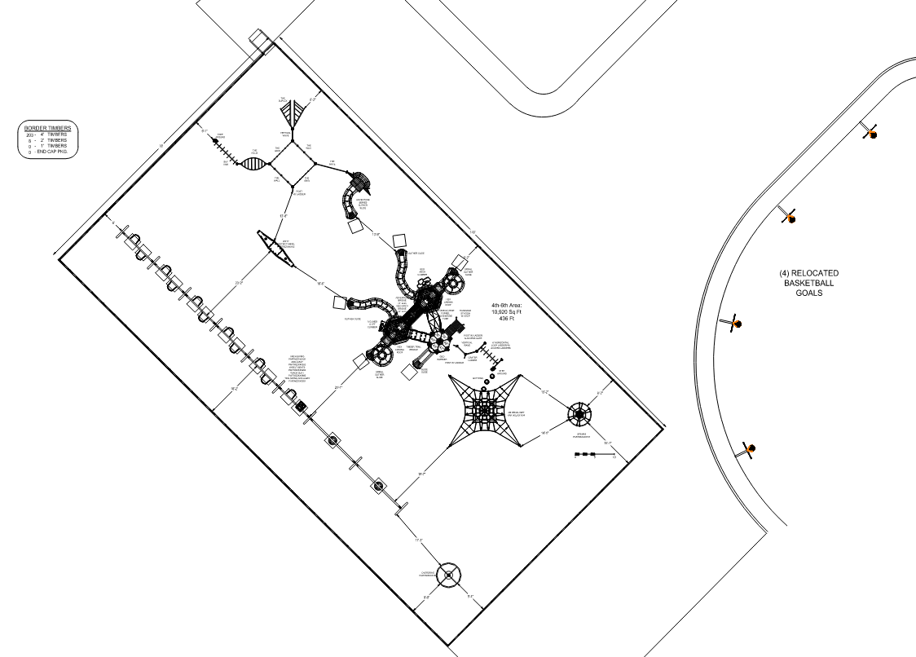
Playgrounds
Park Rapids Additions and Renovations

Slide 13
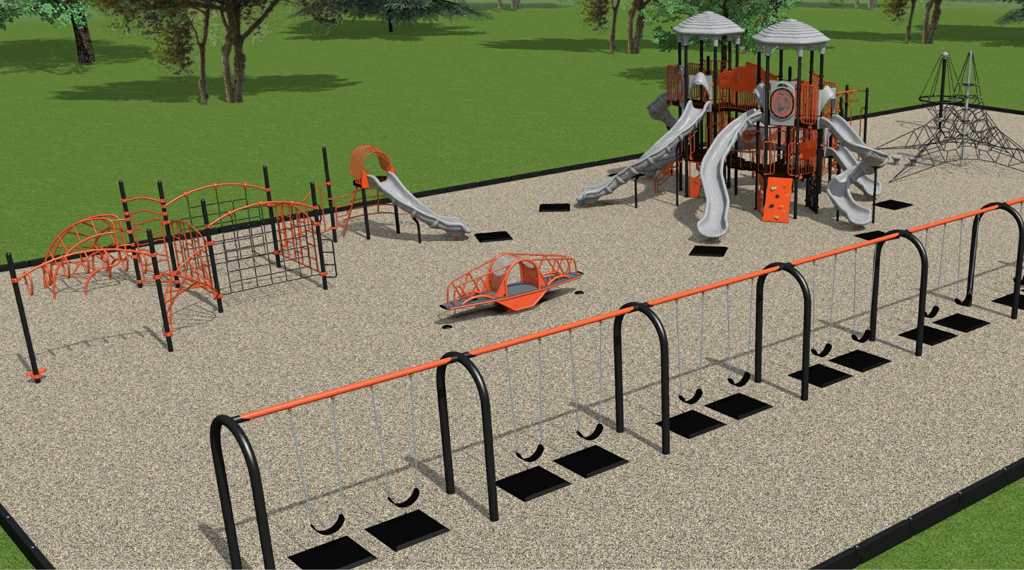
Playgrounds
Park Rapids Additions and Renovations

Slide 14
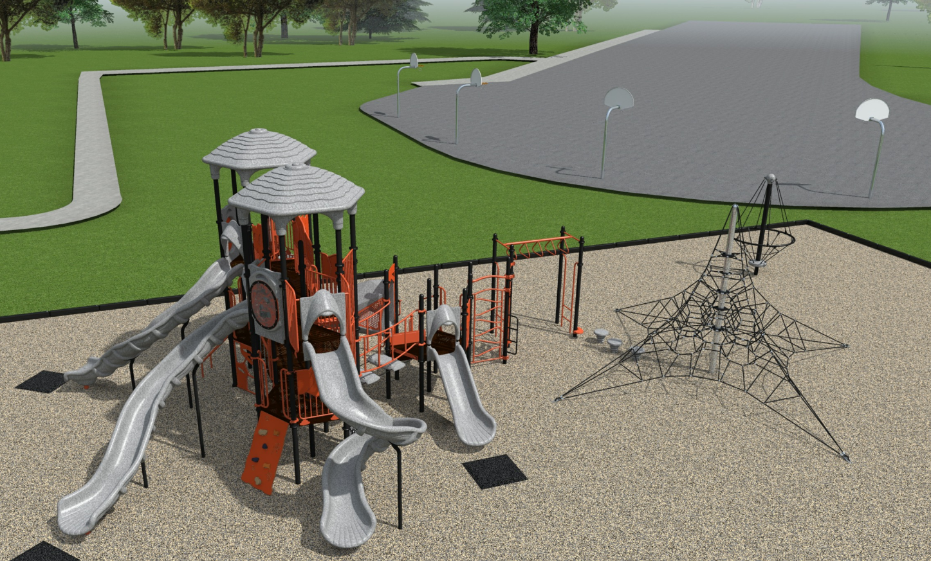
Playgrounds
Park Rapids Additions and Renovations

Slide 15
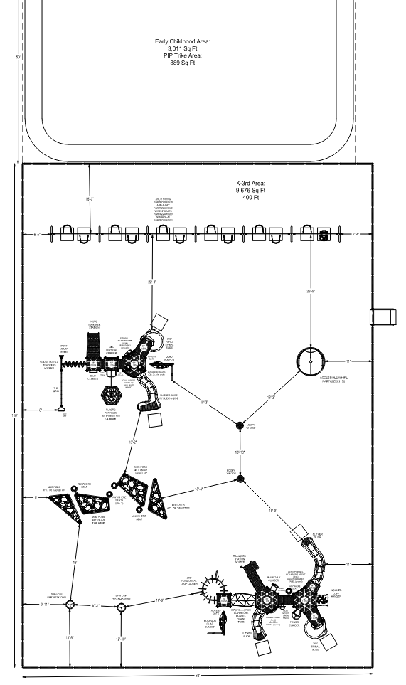
Playgrounds
Park Rapids Additions and Renovations

Slide 16
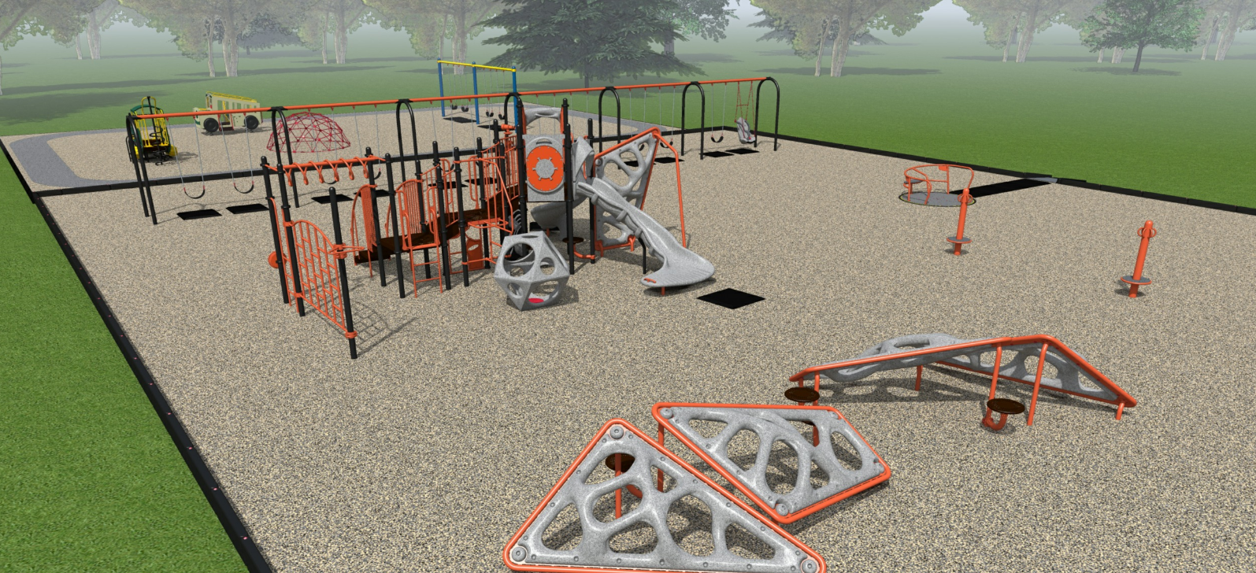
Playgrounds
Park Rapids Additions and Renovations

Slide 17
Recommendations
We recommend entering into contract with NorSon and Midwest Playgrounds
Park Rapids Additions and Renovations

Slide 18
Questions?

