Slide 1
Board Update
High School – BP #1 Precast – Approval to Award Contract
October 3rd, 2022
Park Rapids Additions and Renovations
PARK RAPIDS PUBLIC SCHOOLS

Slide 2
What’s Been Done?
Approx. 65% Complete with Construction Documents at High School
Received Bids for BP#1, Precast
Tennis Court Punchlist Completion / Closeout
Metal Panel Refinish Project
Nearing completion
Progress on the Bus Garage Design
Nearing a DD level design
Have held User Group meetings
Park Rapids Additions and Renovations

Slide 3
What’s Been Done? (continued)
Weekly Design Coordination Meetings
Coordination meetings with all design disciplines
Discussed Exterior Finishes
Metal Panels, Precast, Brick, Windows
Furniture Meetings
Held User Group meetings to discuss needs
Park Rapids Additions and Renovations

Slide 4
Upcoming
Continue with Construction Documents at Secondary
CD Completion (Design), December 5th
Construction Documents at Century Parent Pick-up / Drop-off
Design Development Documents at Century Renovations
Bus Garage Design
DD’s Complete, End of October
Playground Design
User Group Meeting recently held
Furniture User Group Meetings
Park Rapids Additions and Renovations

Slide 5
Preliminary Overall Schedule – Subject to Change
Tennis Courts – Summer of ‘22
Bus Garage – Commencing Summer of ‘23
Elementary Parent Pick-up / Drop-off – Summer of ‘23
Elementary Renovations – Summer of ‘24
Frank White Demolition – May/June of ‘23
Secondary Additions – Commence Summer of ‘23 – Complete August of ’24
Secondary Additions (ALC/Trans./Kitchen) – Commence Summer of ‘24 and – Complete
May of ’25 (Reference Phasing Plan)
Secondary Phase 1 Renovations – Summer of ’24 (Reference Phasing Plan)
Secondary Phase 2 Renovations – Summer of ’25 (Reference Phasing Plan)
Park Rapids Additions and Renovations

Slide 6
HS, Bid Package #1 – Precast, Recommendation to Award
Received (3) Bids – Good Coverage!
Low Contractor, Wells Concrete
Wells Bid Came In Under the Estimate
Park Rapids Additions and Renovations

Slide 7
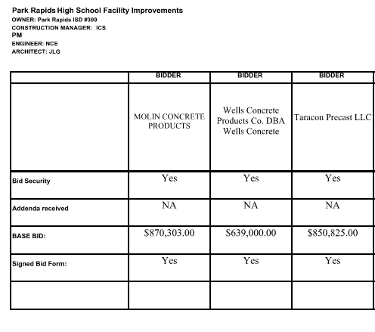

Slide 8
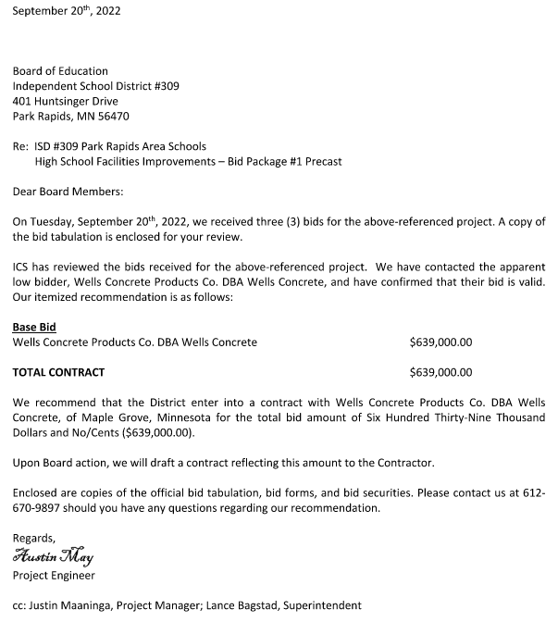

Slide 9
HS, Bid Package #1 – Precast, Recommendation to Award
We recommend awarding the contract to Wells Concrete
Park Rapids Additions and Renovations

Slide 10
Questions?

