Slide 1
Board Update
Tennis Court – Recommendation to Award
May 2nd, 2022
Park Rapids Additions and Renovations
PARK RAPIDS PUBLIC SCHOOLS

Slide 2
What’s Been Done?
Design Development (DD) Progress, Approximately 50% Complete
Held User Group Meetings 1 through 4
Moved into the next step of design and continue to share the plan, gain
input and communicate with staff and administration
Weekly Design Coordination Meetings
Coordination meetings with all design disciplines
Planning/Coordinating the Frank White Move-out / 7th and 8th Move / Early Childhood Move
A sub-committee has been formed to address this
Hope to vacate Frank White Completely by March/April of ‘23
Scheduled the Soil Investigation Work at Parking Areas and New Construction
Park Rapids Additions and Renovations

Slide 3
What’s Been Done?
Bid out the Tennis Courts
Held a Staff Tour at Sartell Schools
Park Rapids Additions and Renovations

Slide 4
Upcoming
Design Development Phase!
Continuing to make progress in this design phase
User Group Meeting #5 within the Design Development Phase
Scheduled for this week
Award and Start Construction of the New Tennis Courts
Continue with Design of the Parking Areas, Playgrounds and Bus Garage
Continue Frank White / 7th and 8th Move / Early Childhood Move
Park Rapids Additions and Renovations

Slide 5
Preliminary Overall Schedule – Subject to Change
Tennis Courts – Summer of ‘22
Bus Garage – Summer of ‘23
Elementary Parent Pick-up / Drop-off – Summer of ‘23
Elementary Renovations – Summer of ‘24
Frank White Relocation – TBD
Frank White Demolition – May/June of ‘23
Secondary Additions – Commence Summer of ‘23 – Complete June of ’24
Secondary Additions (ALC/Kitchen) – Commence Summer of ‘24 and – Complete
May of ‘25
Secondary Phase 1 Renovations – Summer of ‘24
Secondary Phase 2 Renovations – Summer of ‘25
Park Rapids Additions and Renovations

Slide 6
Tennis Courts – Recommendation to Award
Received (4) Proposals – Good Coverage!
Low Contractor, Gladen, Under Estimate
Contractor Intends on Starting Soon
Park Rapids Additions and Renovations

Slide 7
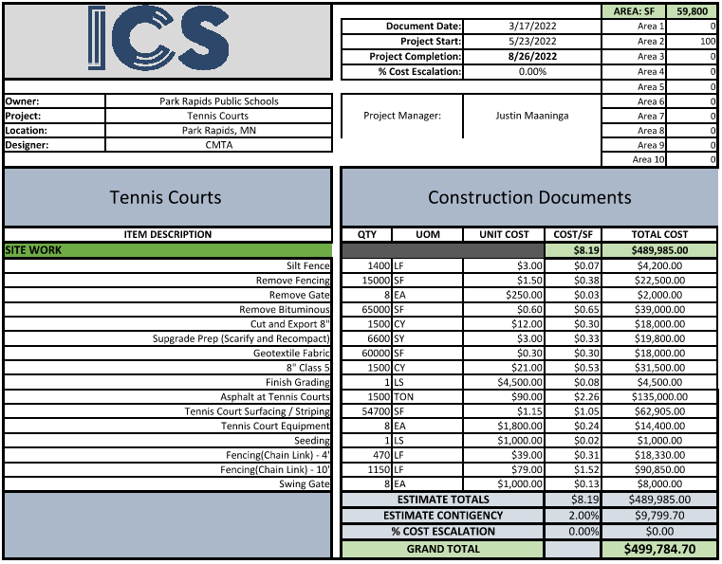
Park Rapids Additions and Renovations

Slide 8
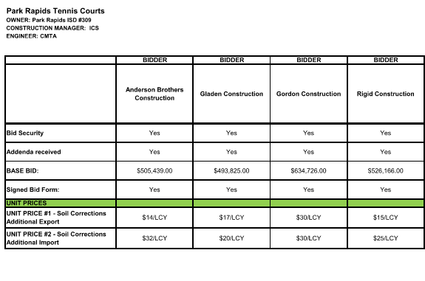
Park Rapids Additions and Renovations

Slide 9
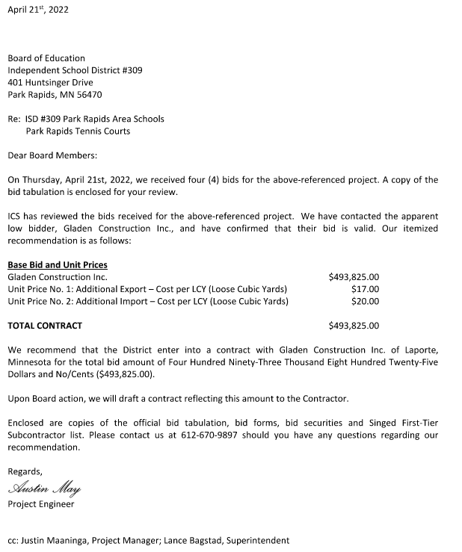
Park Rapids Additions and Renovations

Slide 10
Tennis Courts – Recommendation to Award
We recommend awarding the contract to Gladen Construction, Inc.
Park Rapids Additions and Renovations

Slide 11
Questions?

