Slide 1
Board Update
June 6th, 2022
Park Rapids Additions and Renovations
PARK RAPIDS PUBLIC SCHOOLS

Slide 2
What’s Been Done?
Design Development (DD) Progress, Approximately 75% Complete
Weekly Design Coordination Meetings
Coordination meetings with all design disciplines
Planning/Coordinating the Frank White Move-out / 7th and 8th Move / Early Childhood Move
A sub-committee has been formed to address this
Hope to vacate Frank White Completely by March/April of ‘23
Soil Investigation Work Completed
Commenced with Tennis Court Construction
Park Rapids Additions and Renovations

Slide 3
Tennis Court Update
Demolition and Existing Subgrade Removal – Complete
Next Steps
Bring to grade with new fill
Paving
Surfacing / Striping
Fencing / Equipment
Park Rapids Additions and Renovations

Slide 4
Tennis Court Update – Schedule
Park Rapids Additions and Renovations

Slide 5
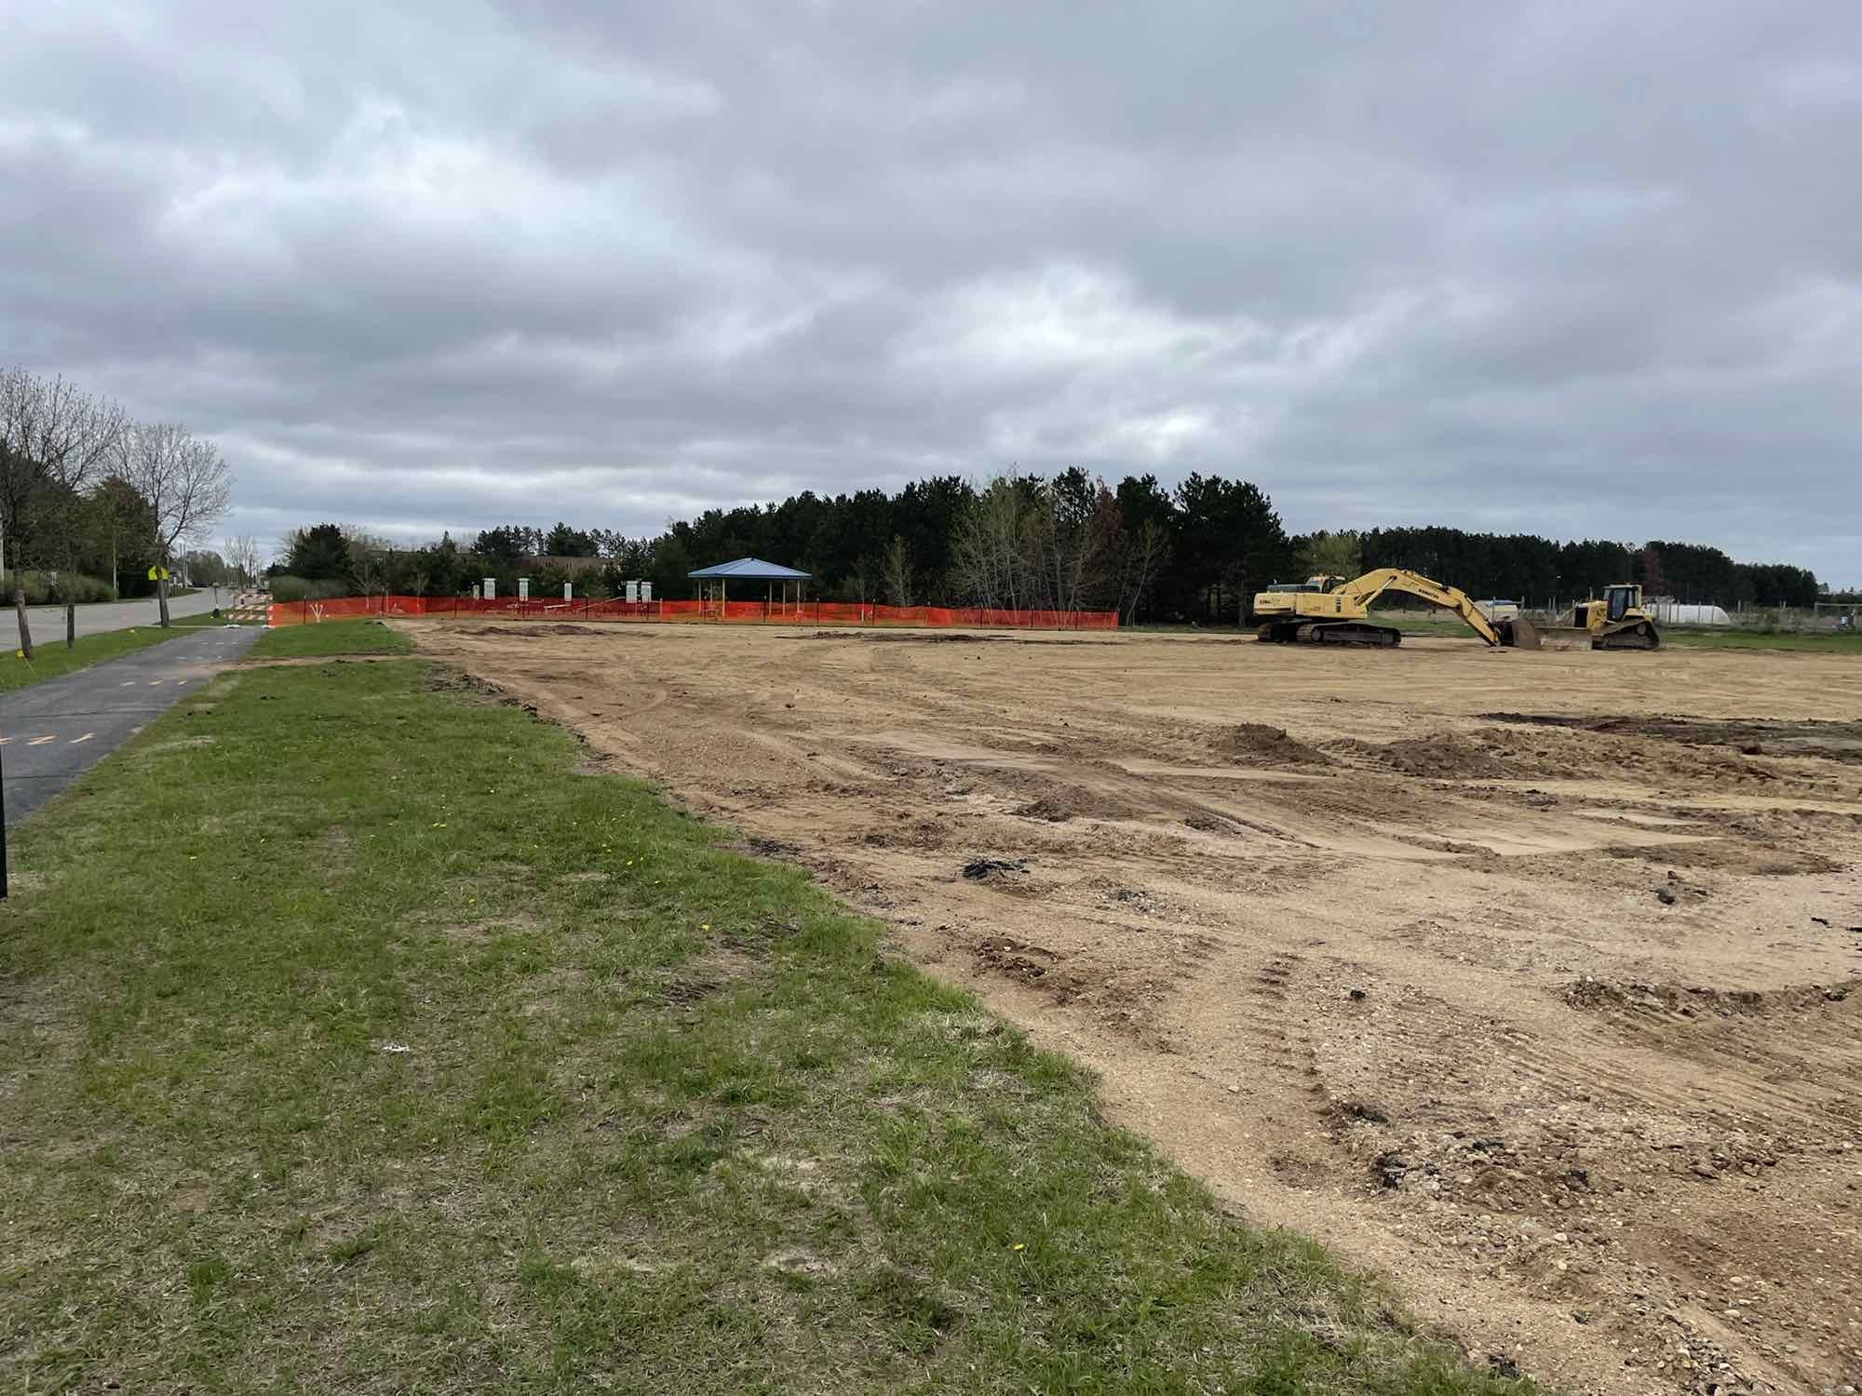
Tennis Court Update

Slide 6
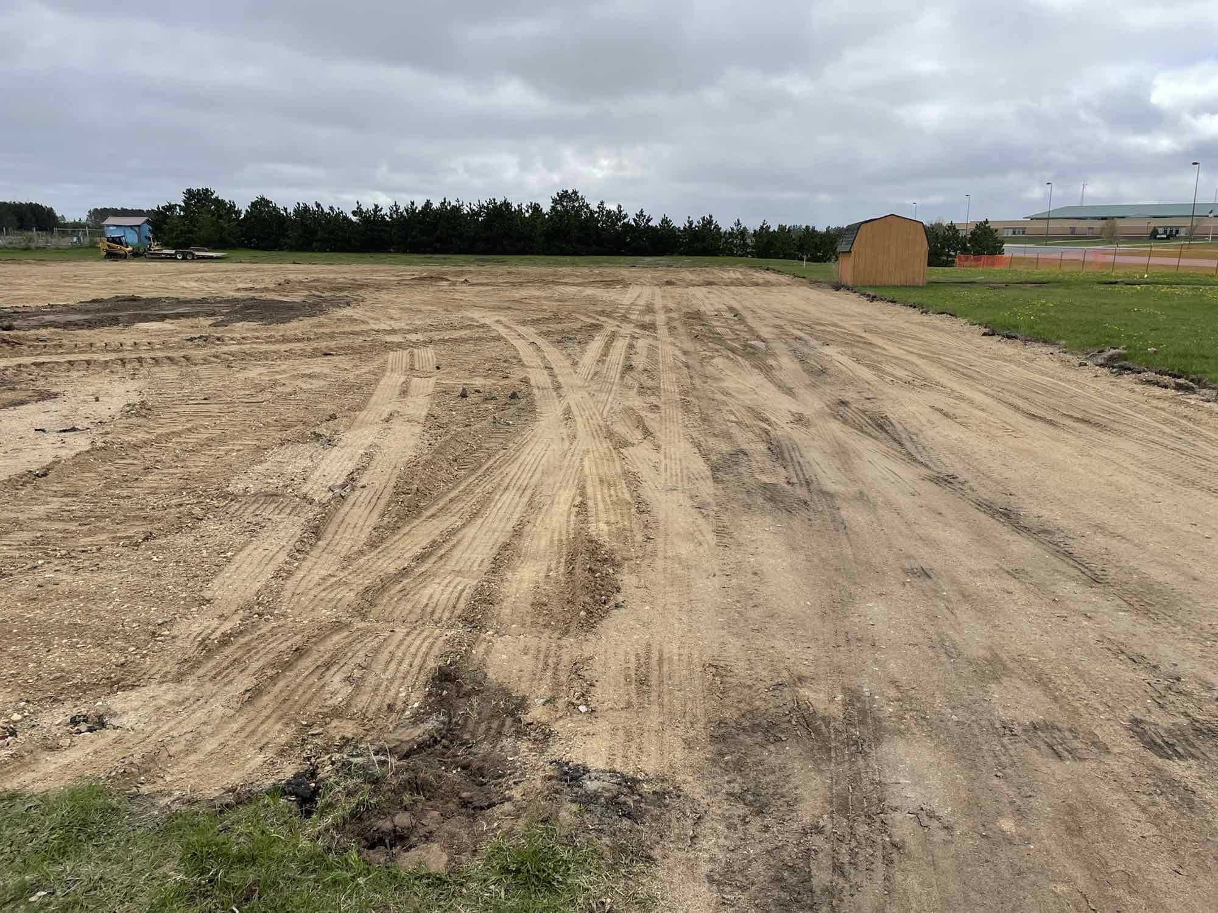
Tennis Court Update

Slide 7
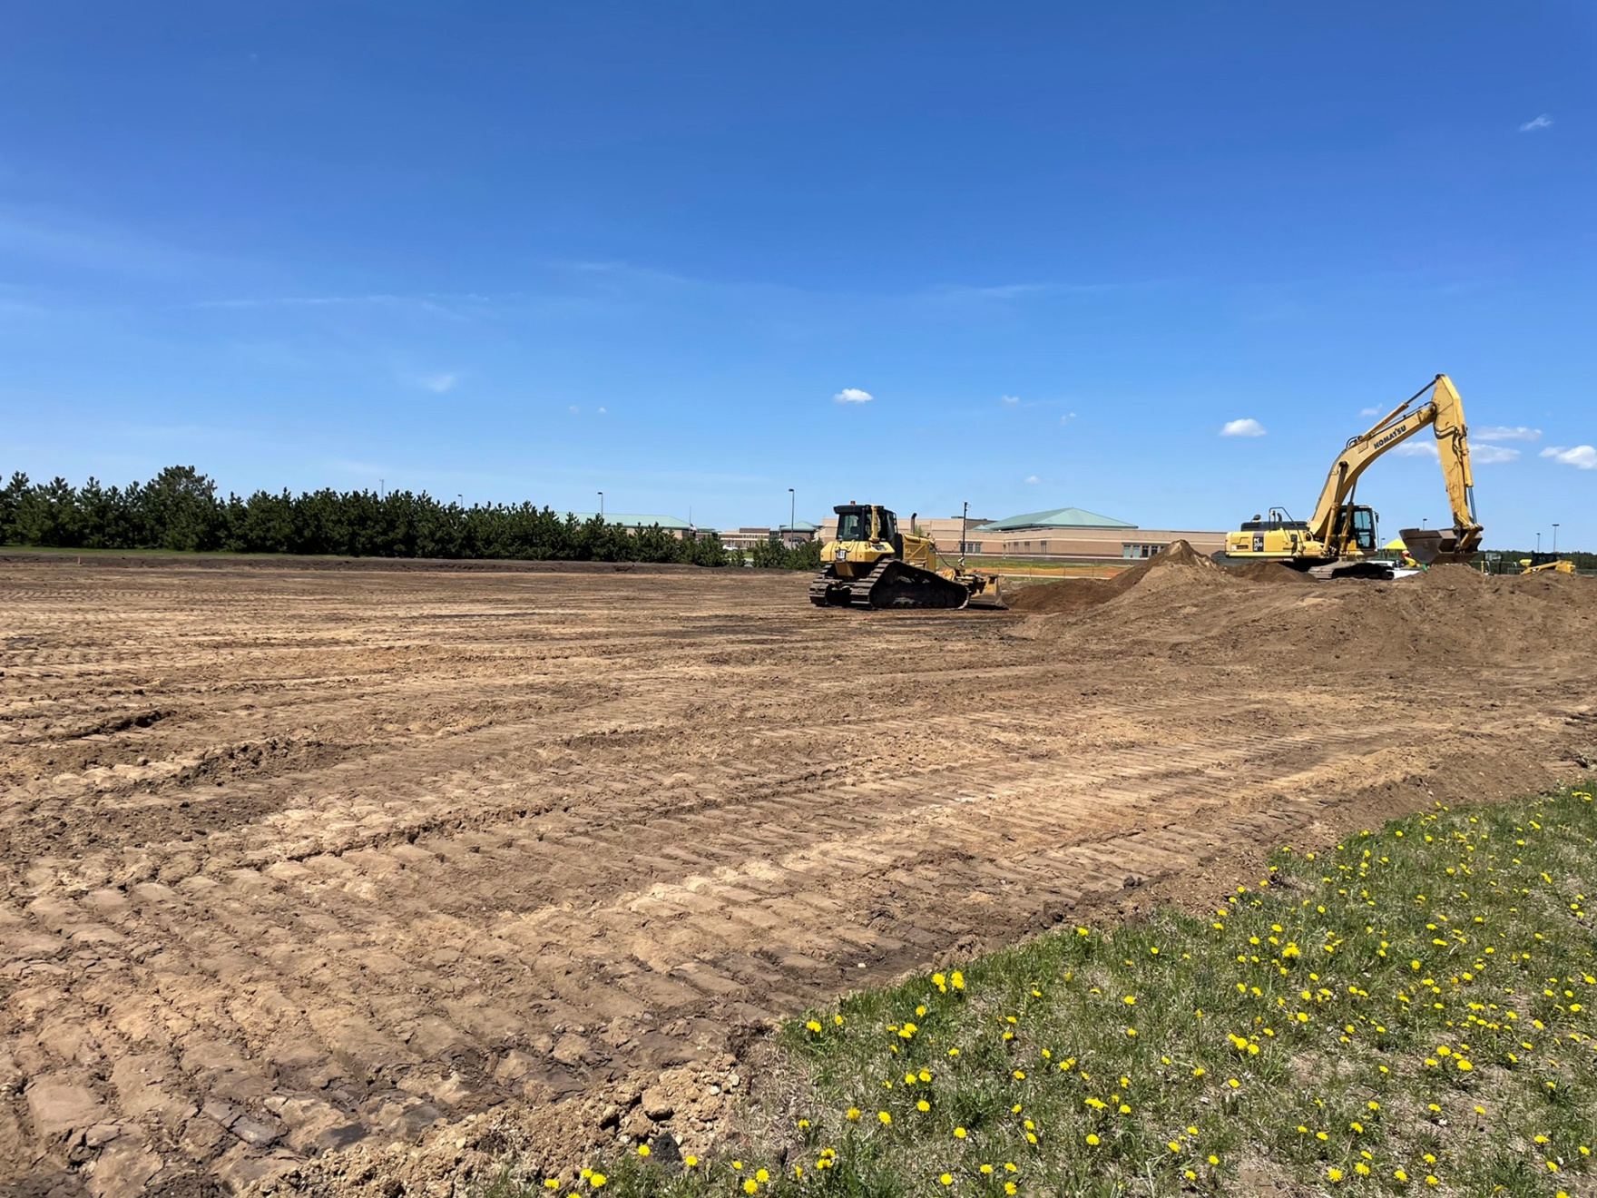
Tennis Court Update

Slide 8
Upcoming
Design Development Phase
Work towards completing this phase
Continue Construction at the Tennis Court
Continue with Design of the Parking Areas, Playgrounds and Bus Garage
Continue Frank White / 7th and 8th Move / Early Childhood Move Discussions
Park Rapids Additions and Renovations

Slide 9
Preliminary Overall Schedule – Subject to Change
Tennis Courts – Summer of ‘22
Bus Garage – Summer of ‘23
Elementary Parent Pick-up / Drop-off – Summer of ‘23
Elementary Renovations – Summer of ‘24
Frank White Relocation – TBD
Frank White Demolition – May/June of ‘23
Secondary Additions – Commence Summer of ‘23 – Complete June of ’24
Secondary Additions (ALC/Kitchen) – Commence Summer of ‘24 and – Complete
May of ‘25
Secondary Phase 1 Renovations – Summer of ‘24
Secondary Phase 2 Renovations – Summer of ‘25
Park Rapids Additions and Renovations

Slide 10
Questions?

