Slide 1
Board Update
Metal Panel Refinish – Recommendation to Award
July 11, 2022
Park Rapids Additions and Renovations
PARK RAPIDS PUBLIC SCHOOLS

Slide 2
What’s Been Done?
Secondary Design Development (DD) Has Been Completed
This is a major milestone!
Weekly Design Coordination Meetings
Coordination meetings with all design disciplines
Construction of the Tennis Courts
Commenced with Playground Discussions / Planning
Received Bids for the Metal Panel Refinish project
Park Rapids Additions and Renovations

Slide 3
Tennis Court Update
Asphalt has been placed
All inspections have passed
Next Steps
Fencing
Surfacing
Equipment
Intend on being complete by the end of the month
Park Rapids Additions and Renovations

Slide 4
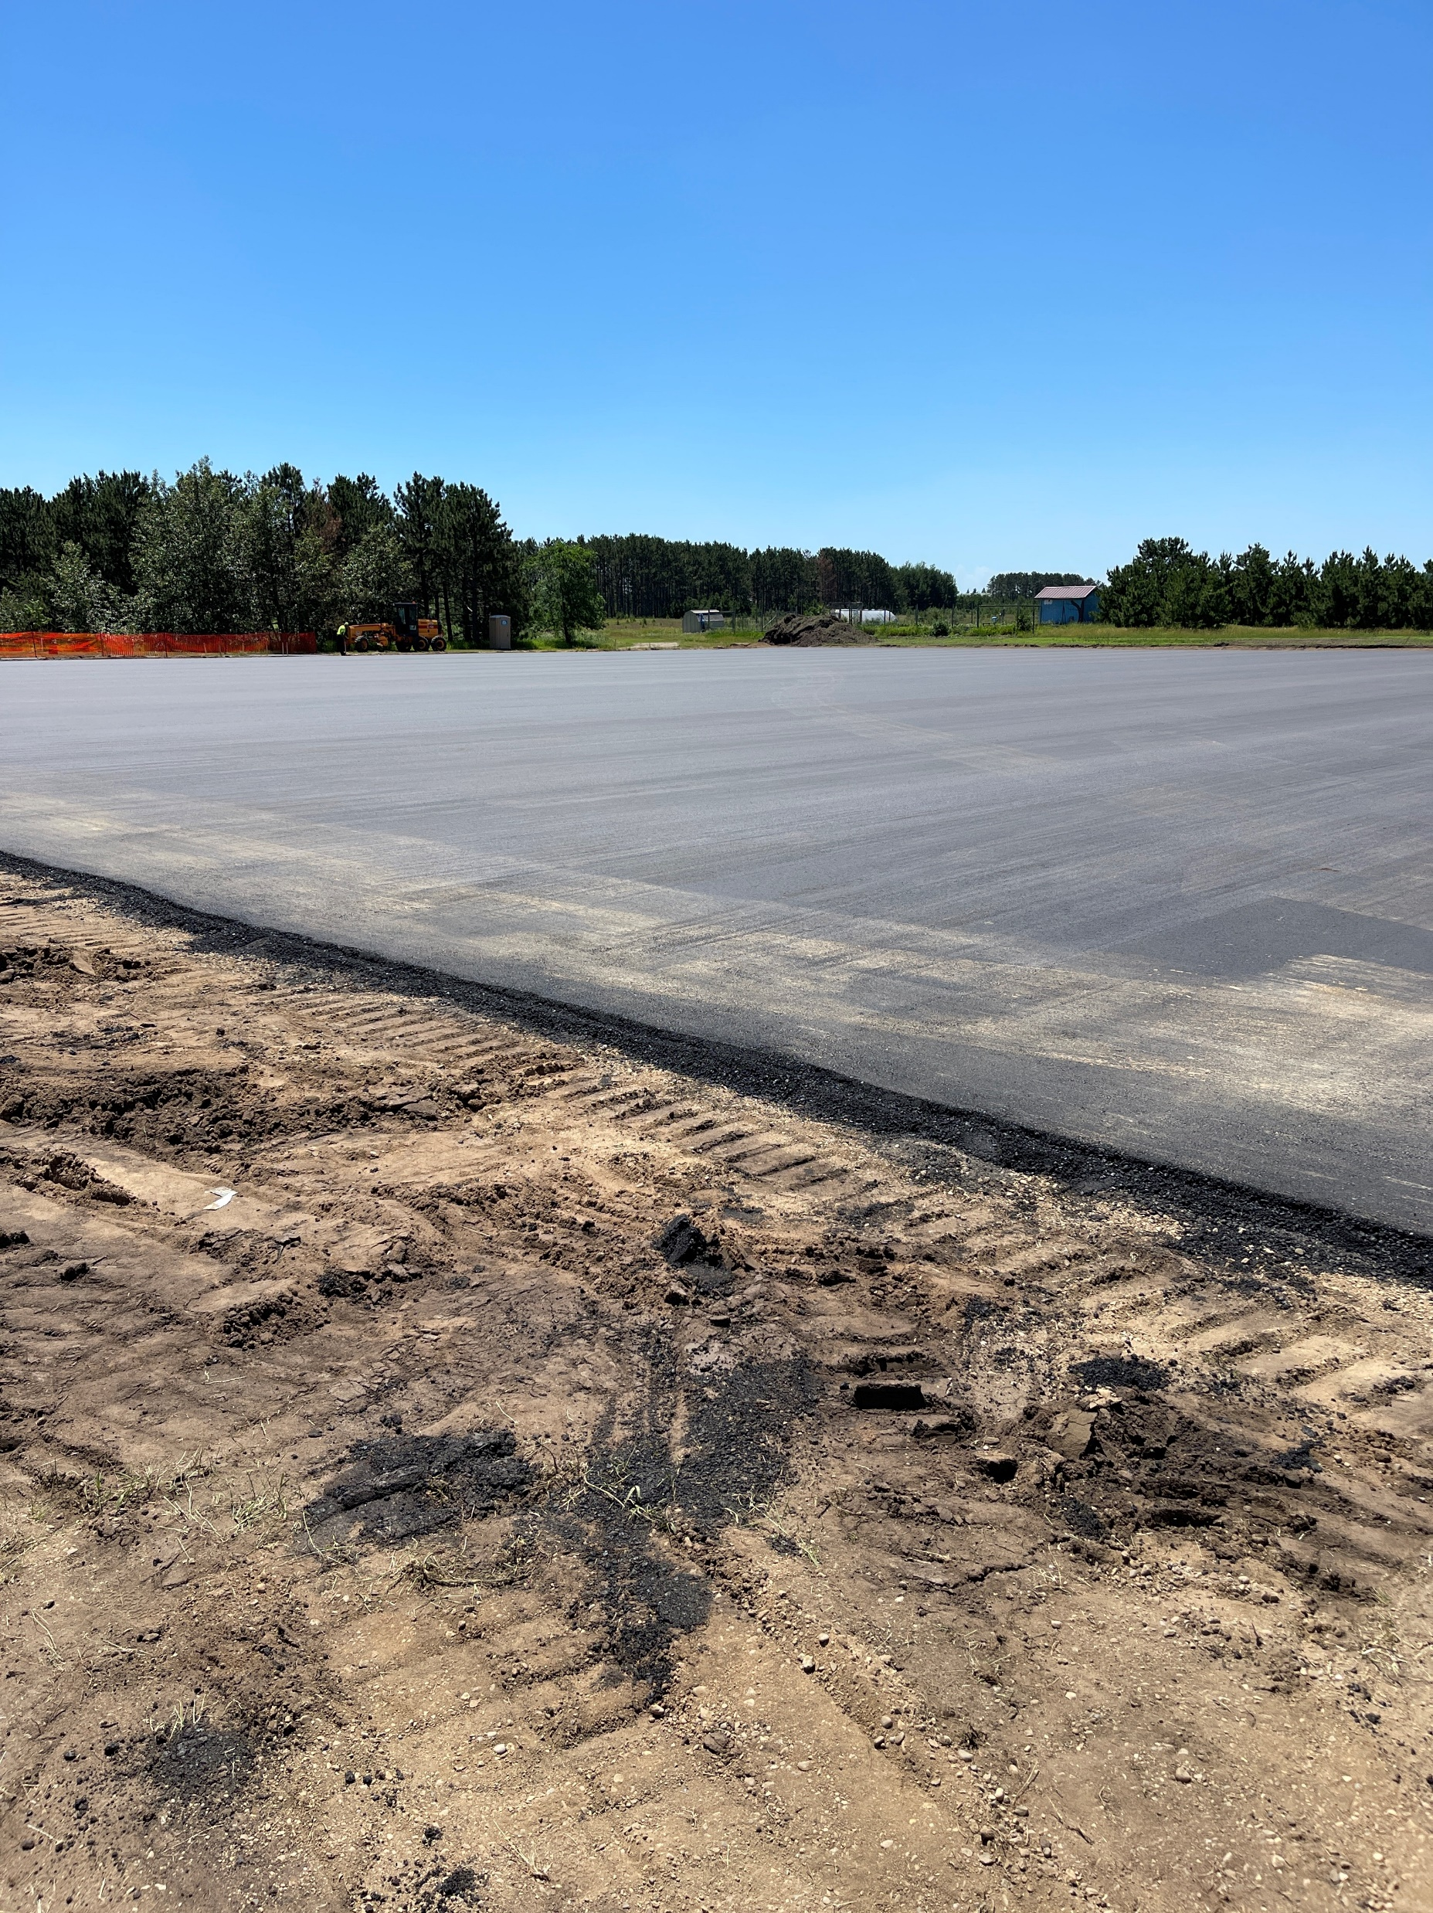
Tennis Court Update

Slide 5
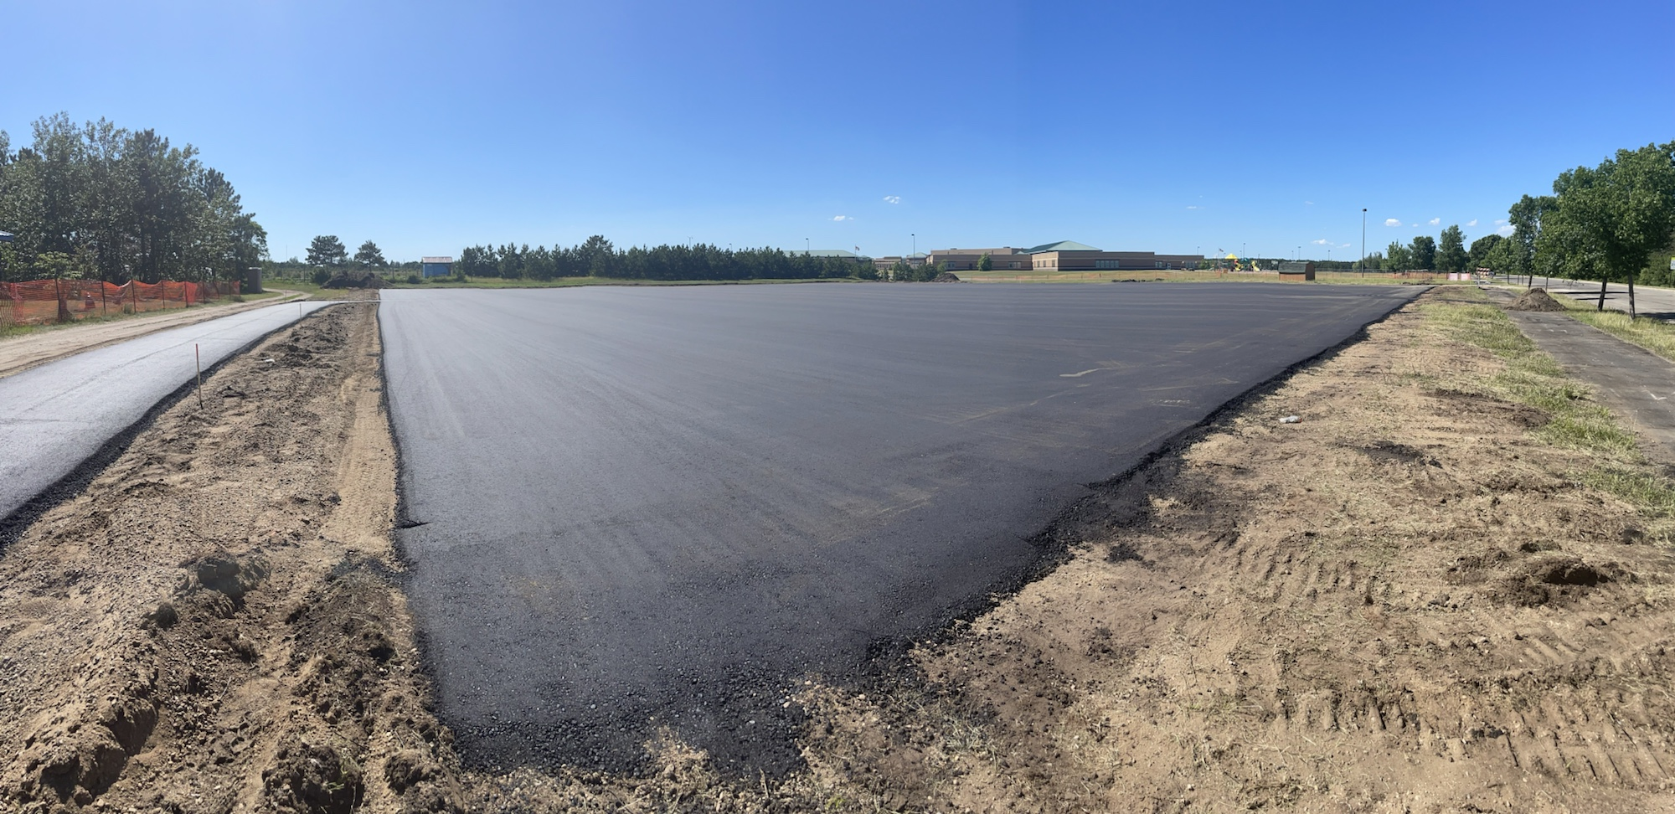
Tennis Court Update

Slide 6
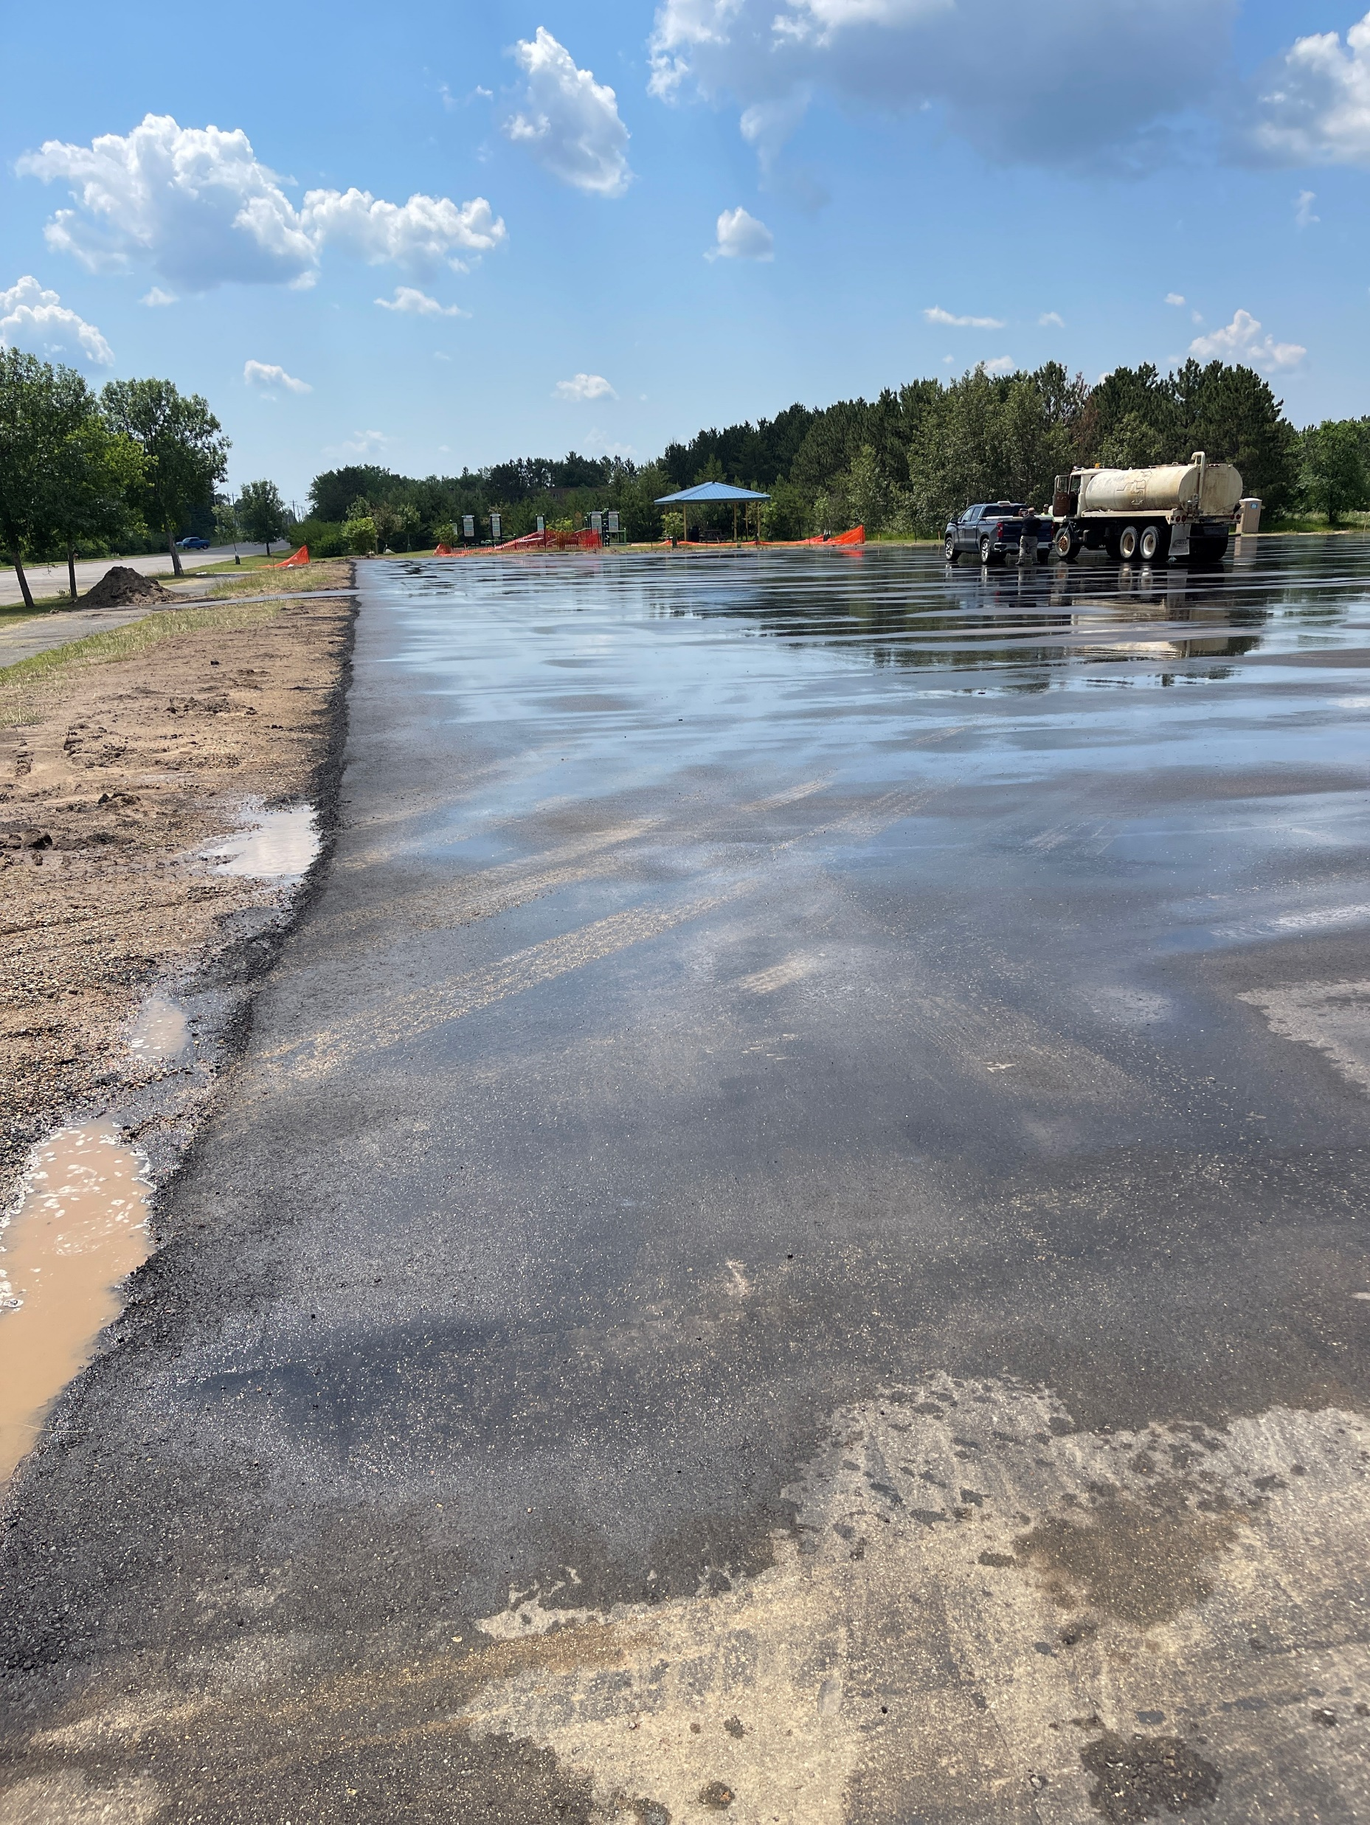
Tennis Court Update

Slide 7
Upcoming
Design Development Phase for Secondary
Complete the DD Estimate
Meet on the 14th to discuss the D.D. package
Continue Construction of the Tennis Court
Continue with Design of the Parking Areas, Playgrounds and Bus Garage and Elementary
Park Rapids Additions and Renovations

Slide 8
Preliminary Overall Schedule – Subject to Change
Tennis Courts – Summer of ‘22
Bus Garage – Summer of ‘23
Elementary Parent Pick-up / Drop-off – Summer of ‘23
Elementary Renovations – Summer of ‘24
Frank White Demolition – May/June of ‘23
Secondary Additions – Commence Summer of ‘23 – Complete June of ’24
Secondary Additions (ALC/Trans./Kitchen) – Commence Summer of ‘24 and – Complete
May of ’25 (Reference Phasing Plan)
Secondary Phase 1 Renovations – Summer of ’24 (Reference Phasing Plan)
Secondary Phase 2 Renovations – Summer of ’25 (Reference Phasing Plan)
Park Rapids Additions and Renovations

Slide 9
Metal Panel Refinish – Recommendation to Award
June 9th, an RFP was issued to Refinish the existing metal panels
Includes sandblasting to prepare metal panels for new finish
Refinishing with a High Performance Coating
Epoxy Base Coat
Acrylic Polyurethane Top Coat
(3) Bids Received:
Gen4 Sandblast and Paint - $122,850.00
Merit Painting, Inc. - $126,000.00
Eco Sandblast and Paint - $174,500.00
Park Rapids Additions and Renovations

Slide 10
Metal Panel Refinish – Recommendation to Award
We recommend awarding the contract to Gen4 Sandblast and Paint
Park Rapids Additions and Renovations

Slide 11
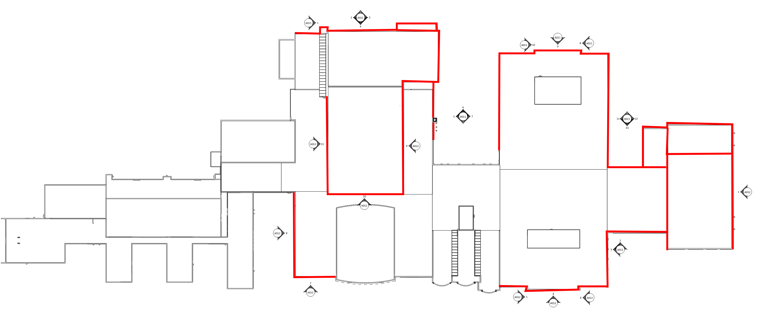
Metal Panel Refinish Areas
Park Rapids Additions and Renovations

Slide 12
Questions?

