Slide 1
Secondary Design Development
July 25, 2022
Park Rapids Additions and Renovations
PARK RAPIDS PUBLIC SCHOOLS

Slide 2
Secondary Design Development
We’ll Review the Following:
Plan Review
High School Phasing / Schedule
Construction Estimate
Park Rapids Additions and Renovations

Slide 3
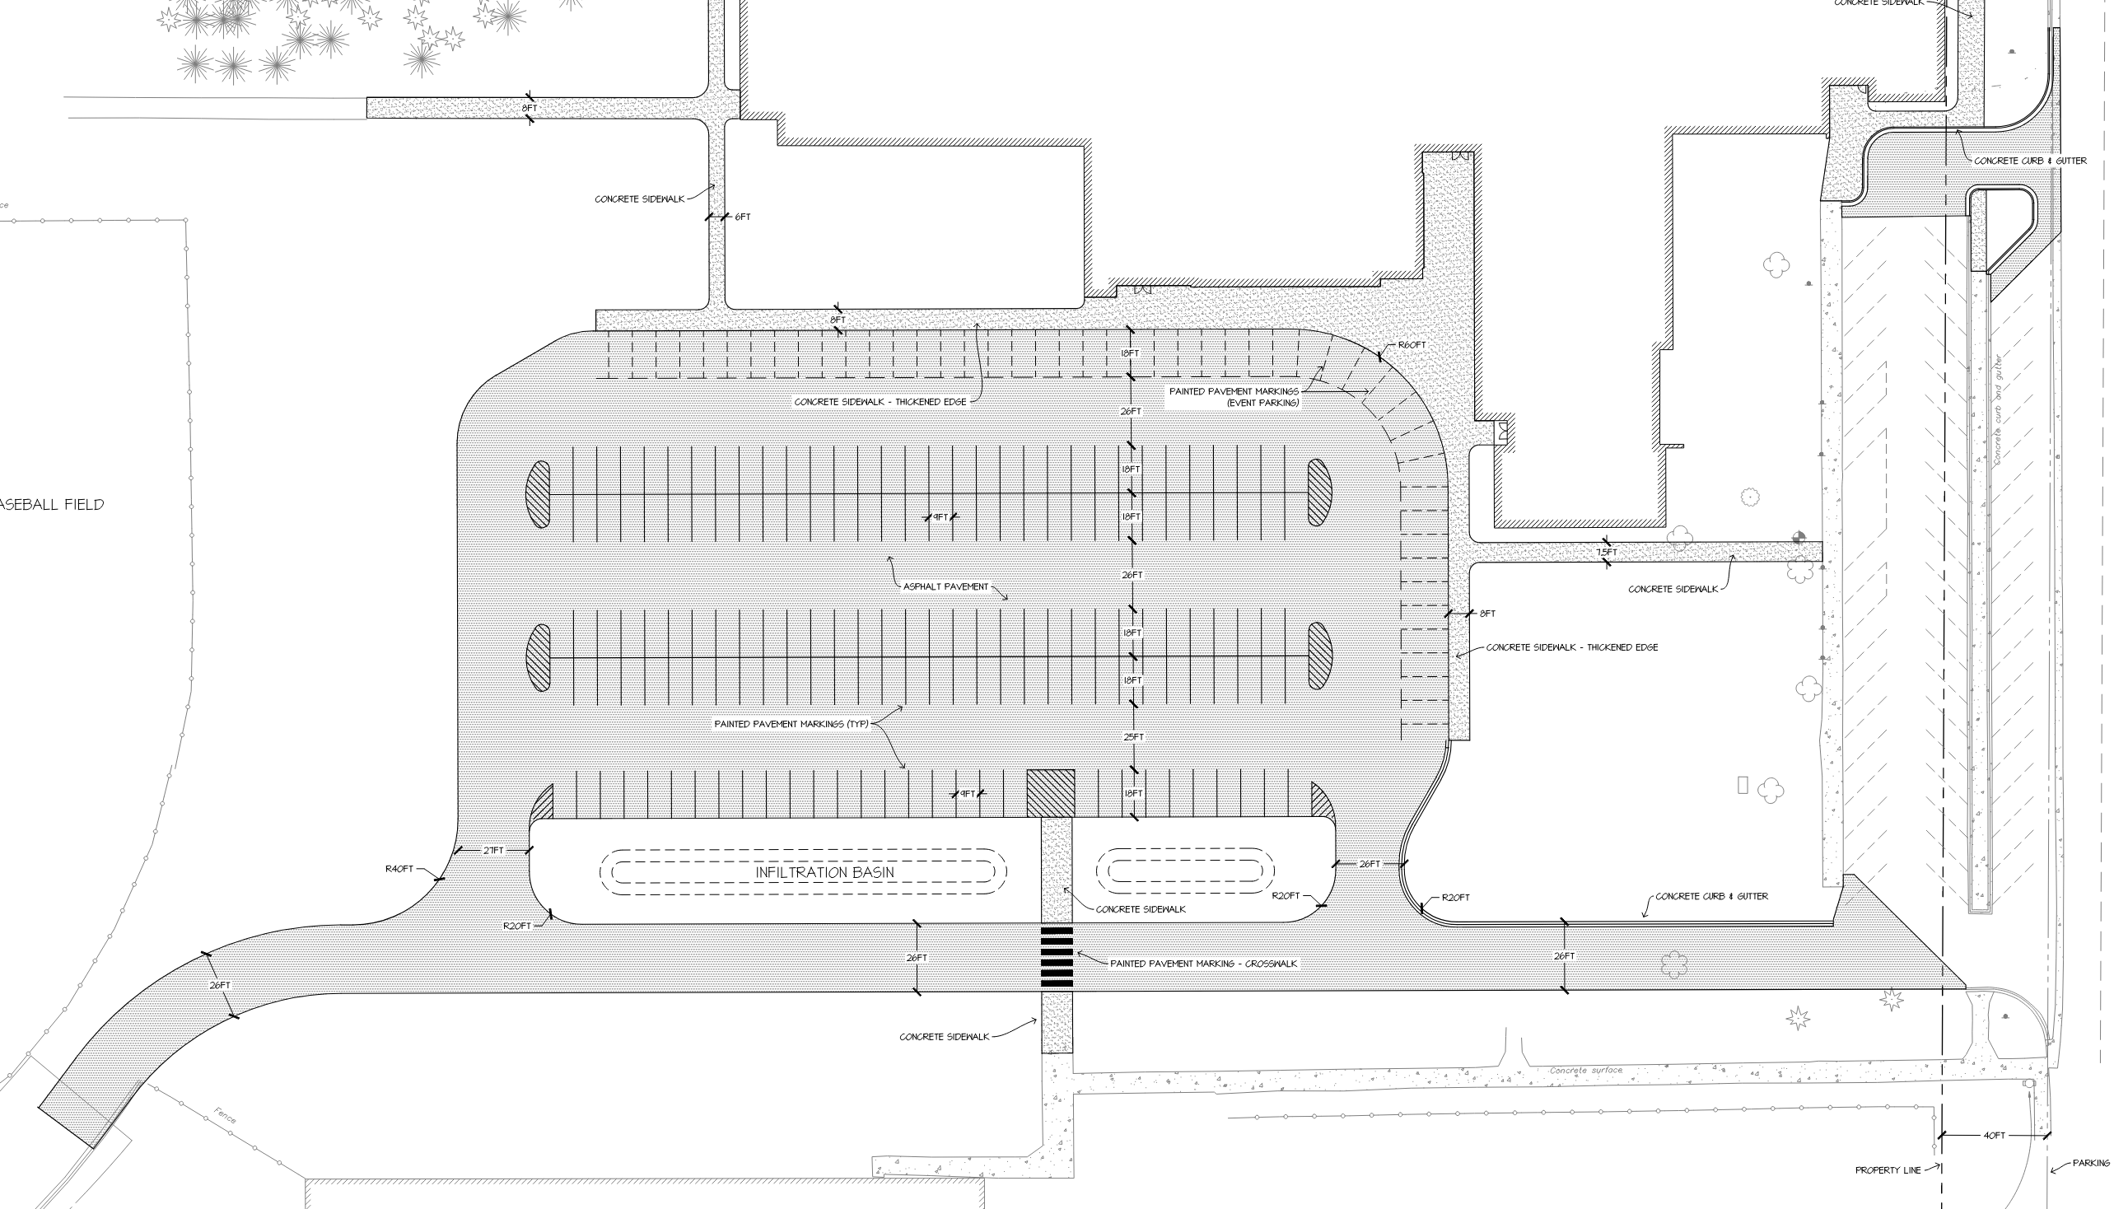
Secondary Design Development – Plan Review
Park Rapids Additions and Renovations

Slide 4
Secondary Design Development – Plan Review
Park Rapids Additions and Renovations

Slide 5
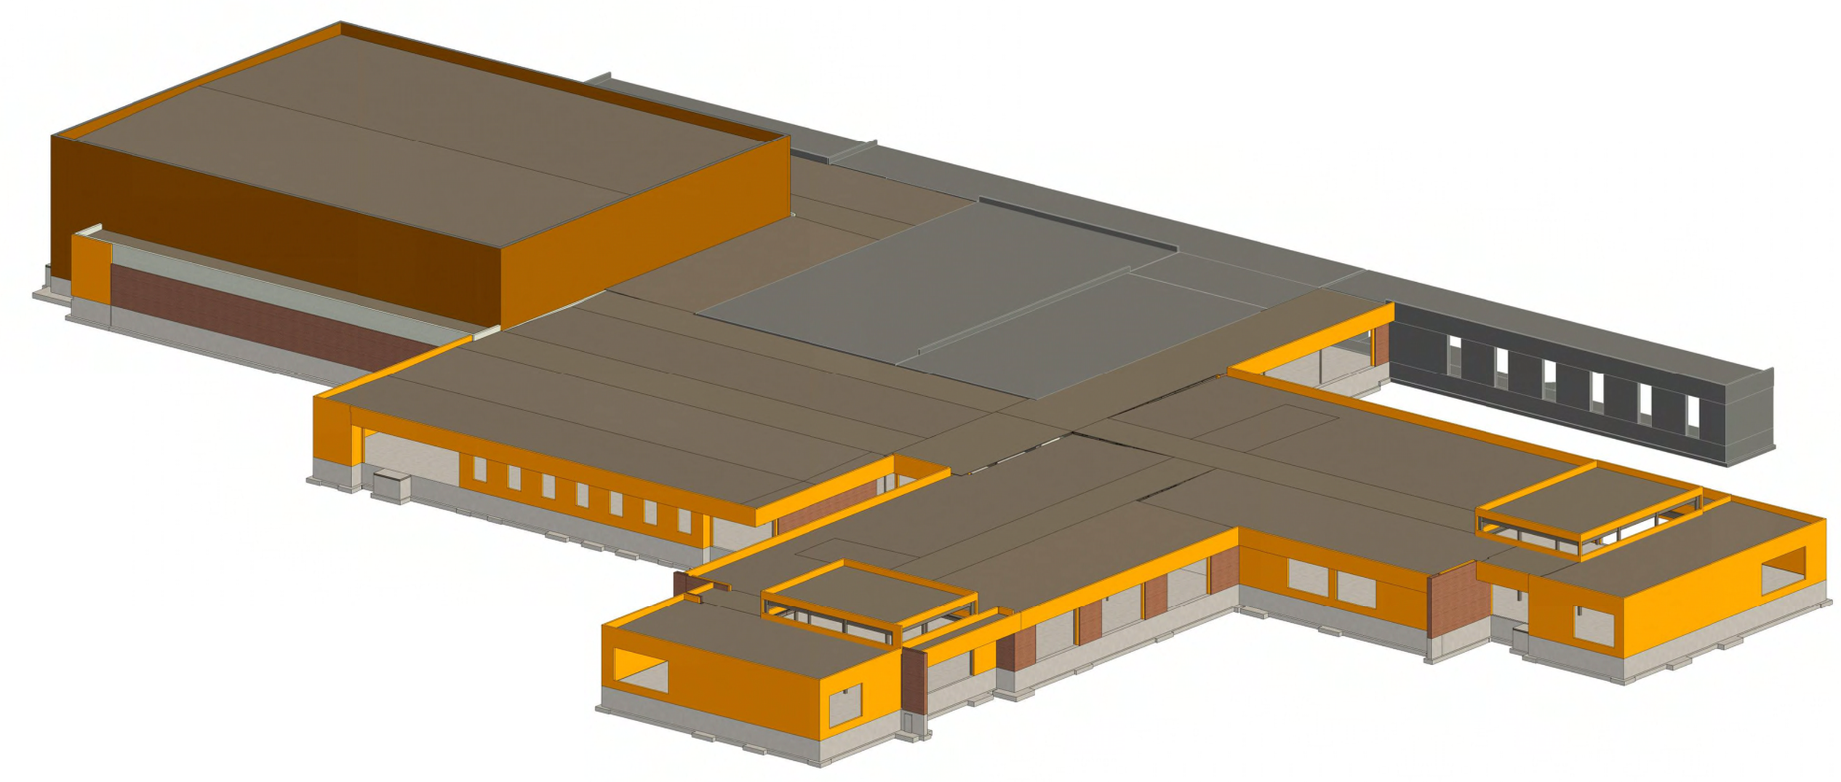
Secondary Design Development – Plan Review
Park Rapids Additions and Renovations

Slide 6
Secondary Design Development – Plan Review
JLG Presentation
Park Rapids Additions and Renovations

Slide 7
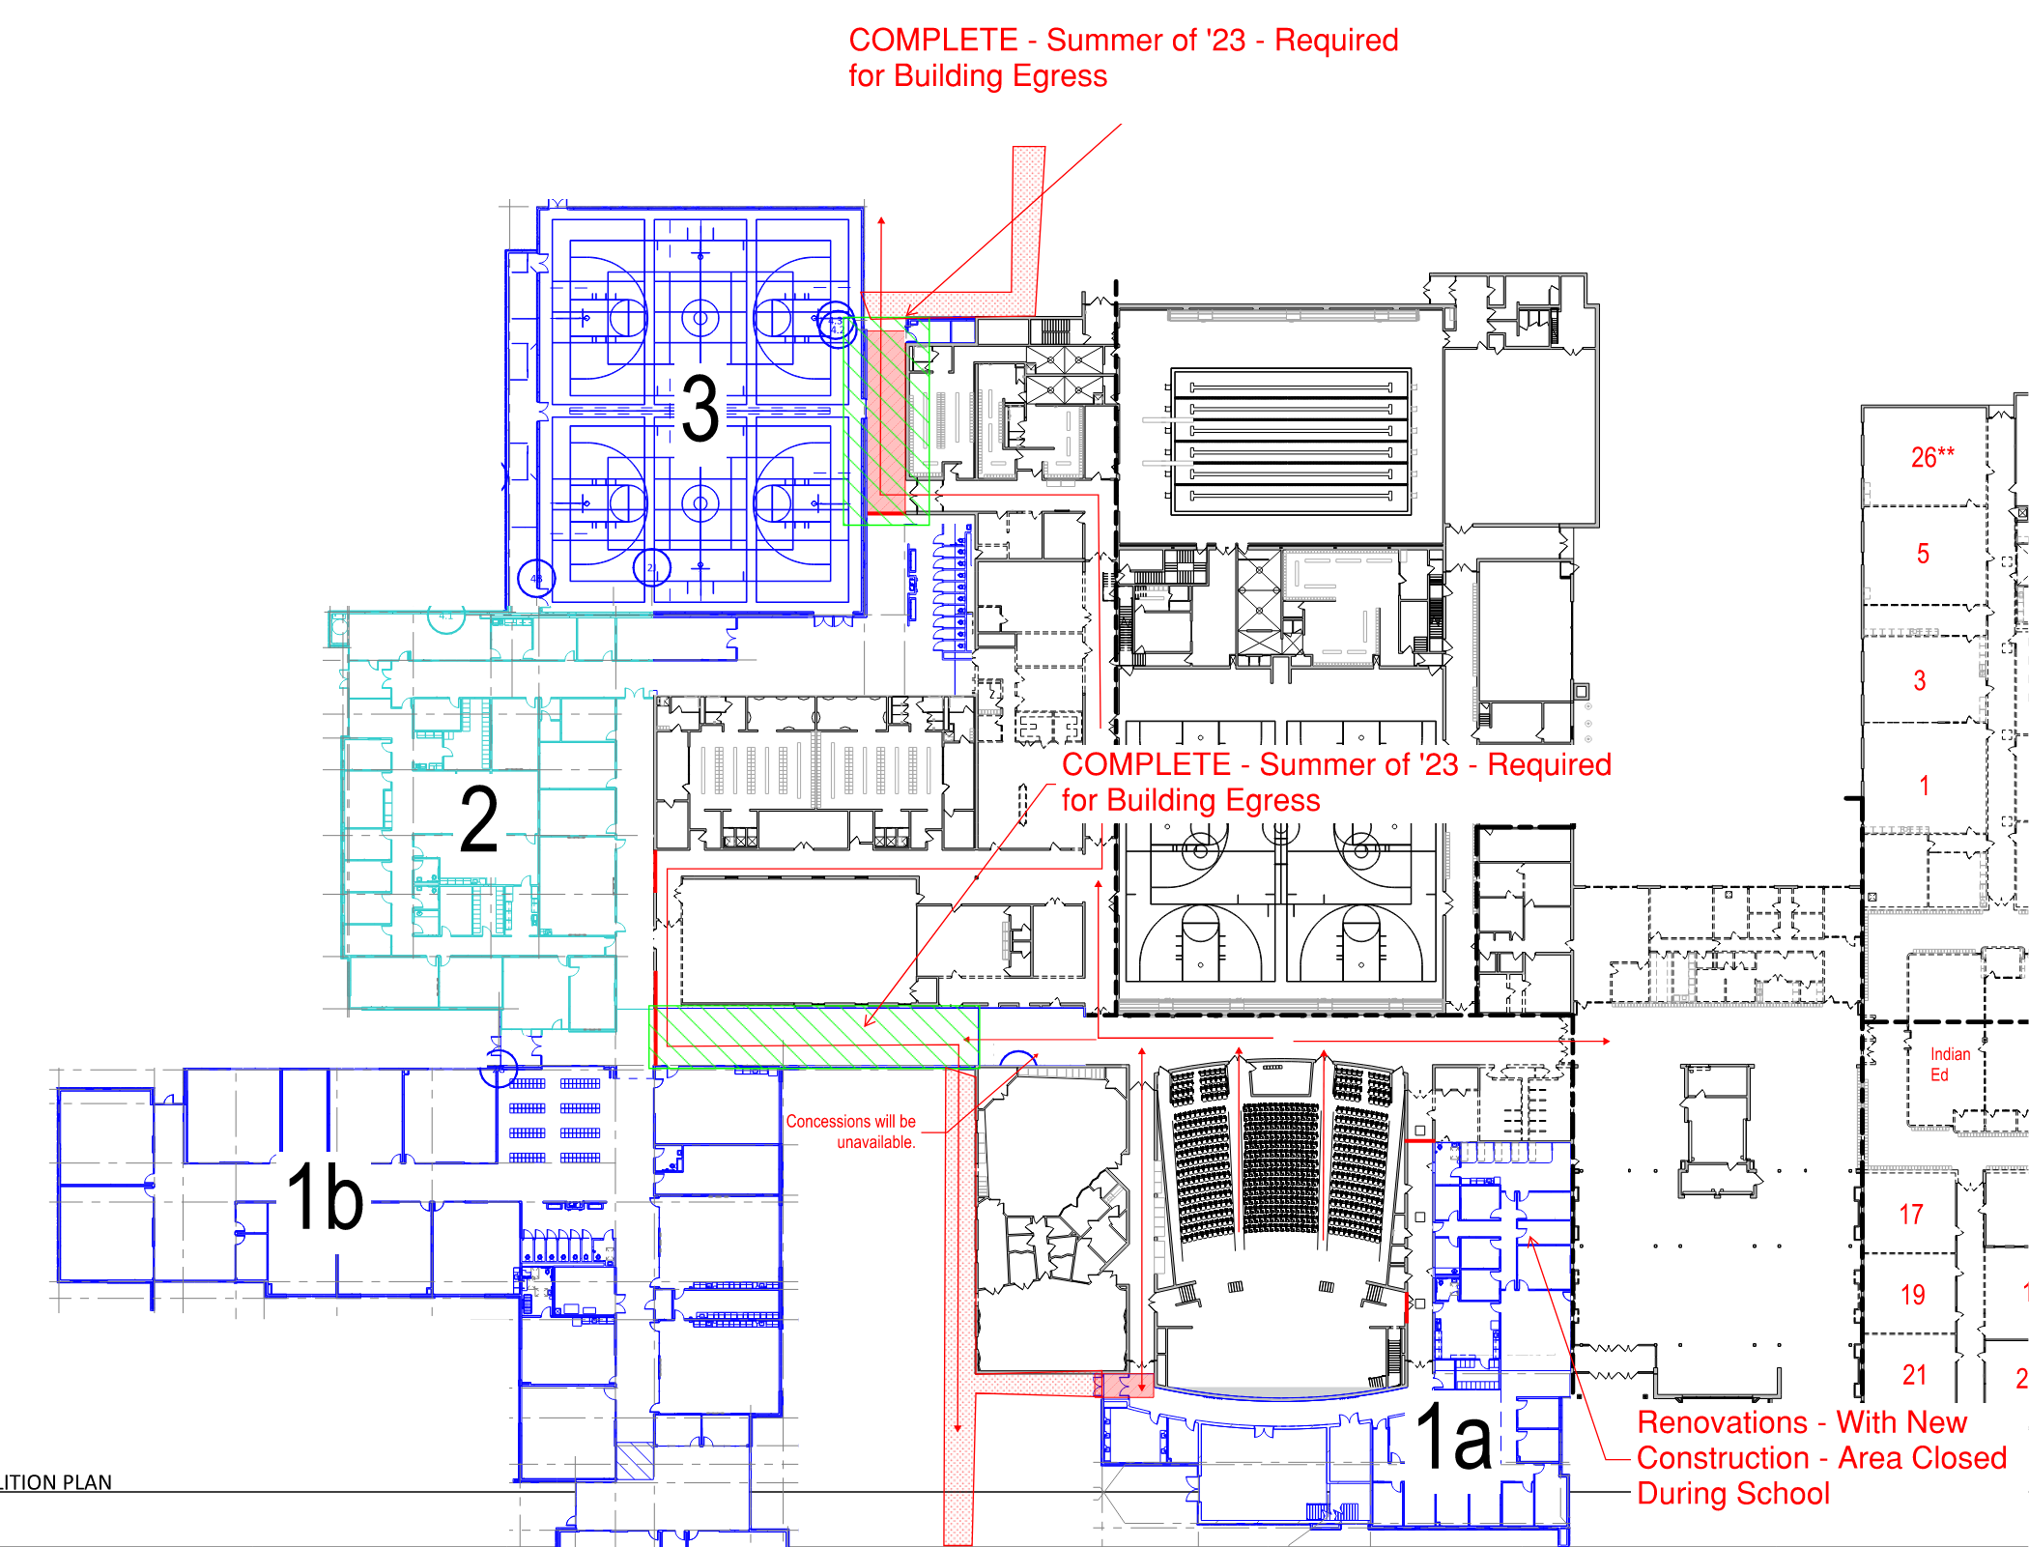
Phase 1 Additions June ‘23 to August ‘24

Slide 8
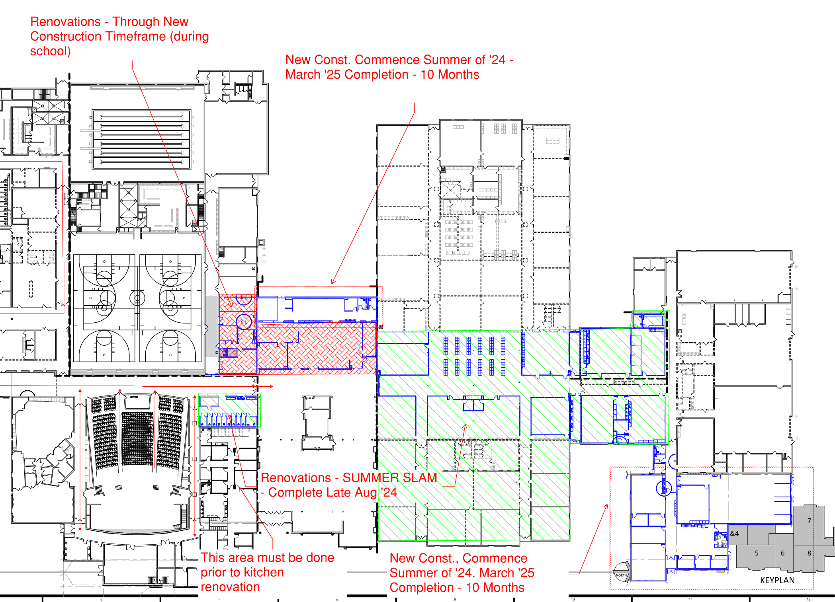
Phase 1 Renovations / Phase 2 Additions Major Renovation – June ‘24 thru August ‘24
Kitchen/ALC/Transportation Additions – June ‘24 through March ‘25

Slide 9
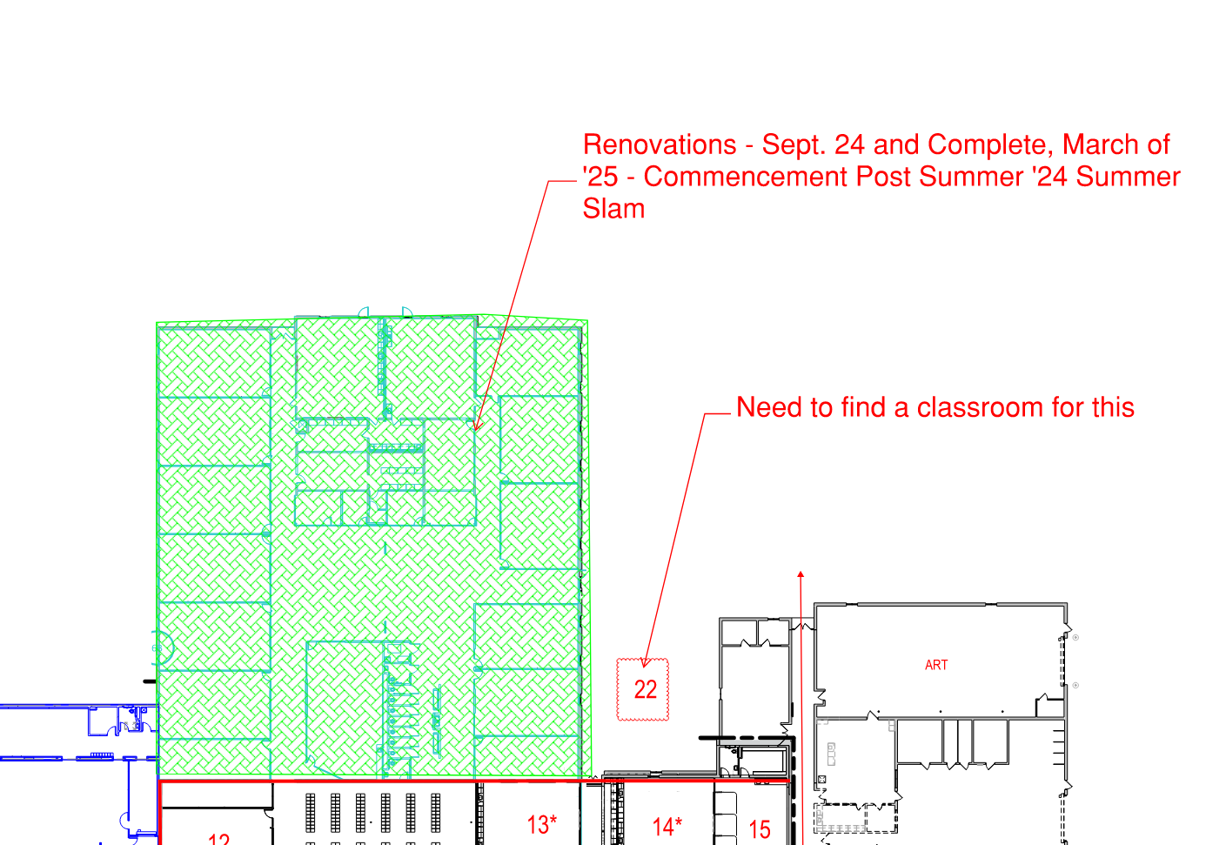
Phase 2 Renovations High School Classrooms - Sept ‘24 through March ‘25

Slide 10
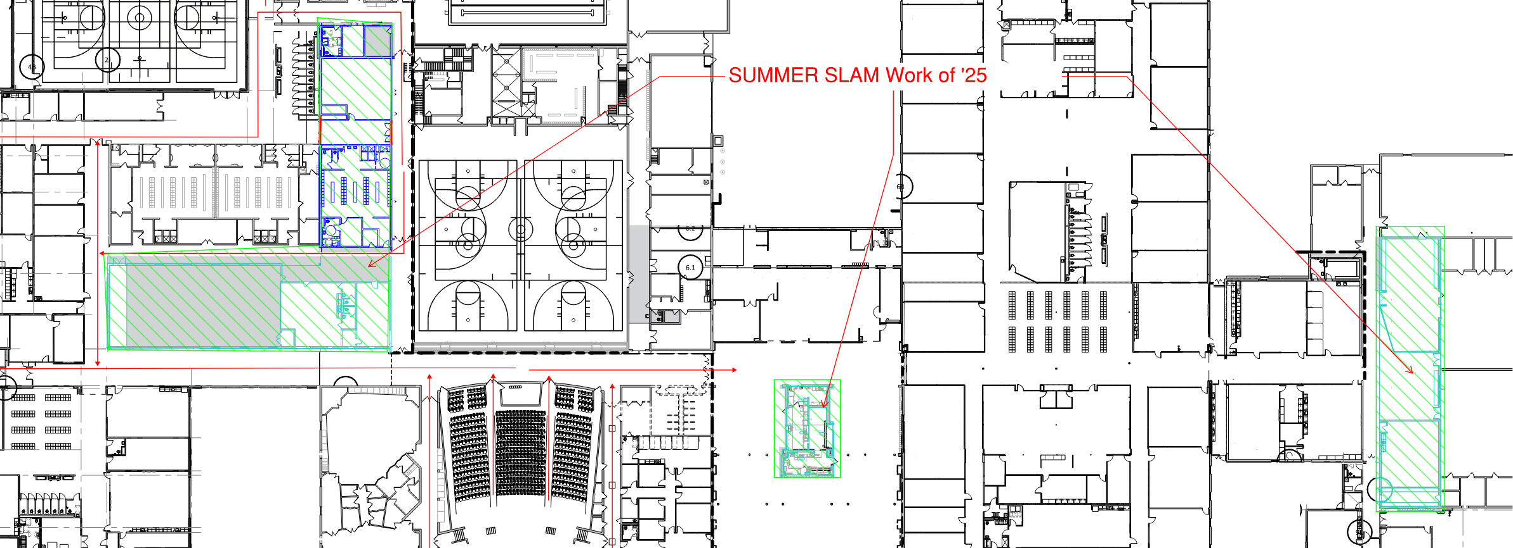
Phase 3 Renovations Locker Rooms, Concessions and CTE – Summer of ‘25

Slide 11
Secondary Design Development - Schedule
Task Name | Duration | Start | Finish
Secondary Additions and Renovations - Precon Schedule | 390 days | Tue 11/2/21 | Mon 5/1/23
Preconstruction | 16 days | Tue 11/2/21 | Tue 11/23/21
Schematic Design | 100 days | Tue 11/2/21 | Mon 3/21/22
Design Development | 85 days | Tue 3/22/22 | Mon 7/18/22
Construction Documents | 210 days | Tue 7/12/22 | Mon 5/1/23
Precast Bid Package #1 Complete by Design Team | 0 days | Fri 8/19/22 | Fri 8/19/22
Construction Documents Process | 105 days | Tue 7/12/22 | Mon 12/5/22
ICS Budget / Schedule Preparation | 10 days | Tue 12/6/22 | Mon 12/19/22
CD Board Approval | 0 days | Mon 12/19/22 | Mon 12/19/22
Bid Procurement | 26 days | Tue 12/20/22 | Tue 1/24/23
Bid Opening | 0 days | Tue 1/24/23 | Tue 1/24/23
Critical Submittals | 20 days | Wed 1/25/23 | Tue 2/21/23
Contract Procurement | 30 days | Wed 1/25/23 | Tue 3/7/23
State Plan Review | 95 days | Tue 12/20/22 | Mon 5/1/23
Task Name | Duration | Start | Finish
Frank White Demolition | 15 days | Mon 5/15/23 | Fri 6/2/23
New Construction - South Additions and HS Admin Additions | 305 days | Mon 6/5/23 | Fri 8/2/24
Phase 1 Renovations - Media and East Clasrooms / Bathrooms | 60 days | Mon 6/3/24 | Fri 8/23/24
New Construction - Kitchen/ALC/Transportation | 195 days | Mon 6/3/24 | Fri 2/28/25
Phase 2 Renovations - West Classrooms (High School) | 135 days | Mon 8/26/24 | Fri 2/28/25
Phase 3 Renovations - Locker Room, Concessions, CTE | 60 days | Mon 6/2/25 | Fri 8/22/25
Park Rapids Additions and Renovations

Slide 12
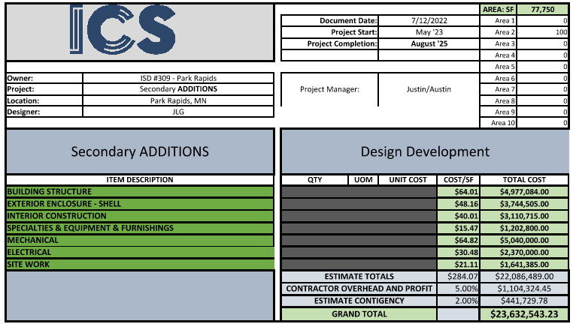
Secondary Design Development - Estimate
Park Rapids Additions and Renovations

Slide 13
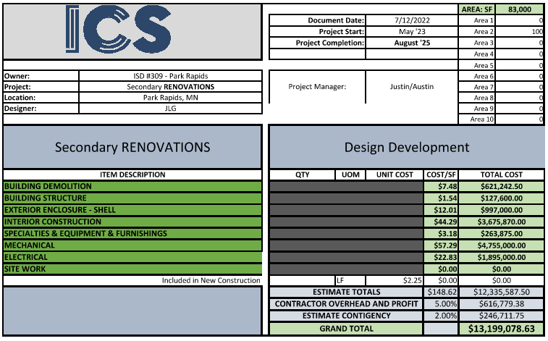
Secondary Design Development - Estimate
Park Rapids Additions and Renovations

Slide 14
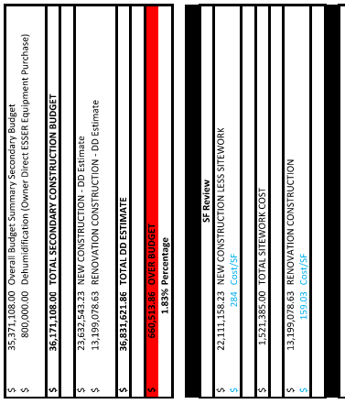
Summary

Slide 15
Secondary Design Development
We Recommend to Approve the Secondary Design Development as Presented
with the Authorization to proceed with Construction Documents
Park Rapids Additions and Renovations

Slide 16
Questions?

