Slide 1
Century Site Improvements – Design Development
September 19th, 2022
Park Rapids Additions and Renovations
PARK RAPIDS PUBLIC SCHOOLS

Slide 2
Secondary Design Development
We’ll Review the Following:
Plan Review
Schedule
Construction Estimate
Park Rapids Additions and Renovations

Slide 3
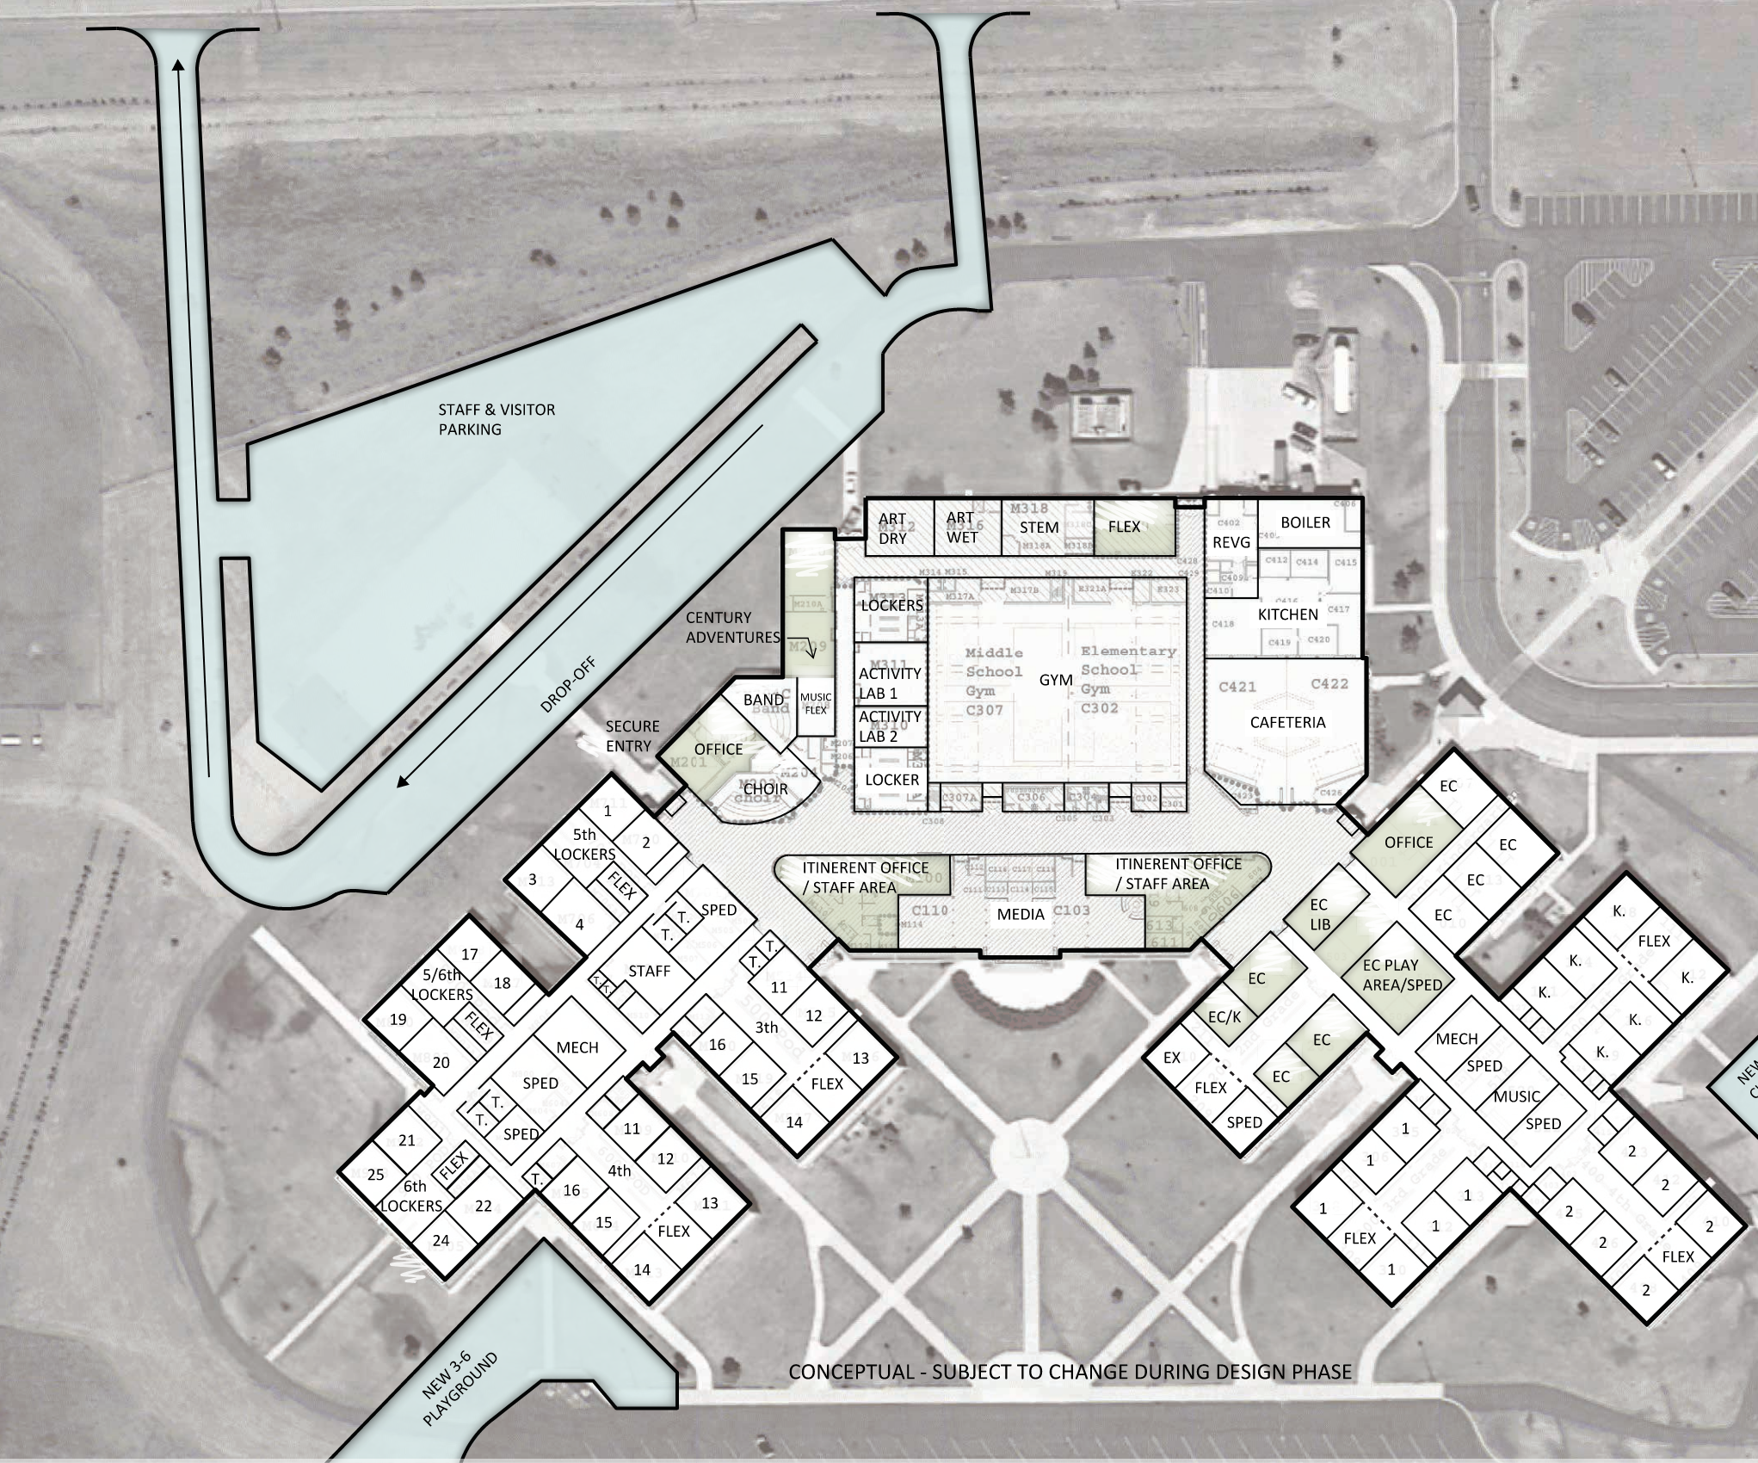
Referendum Plan

Slide 4
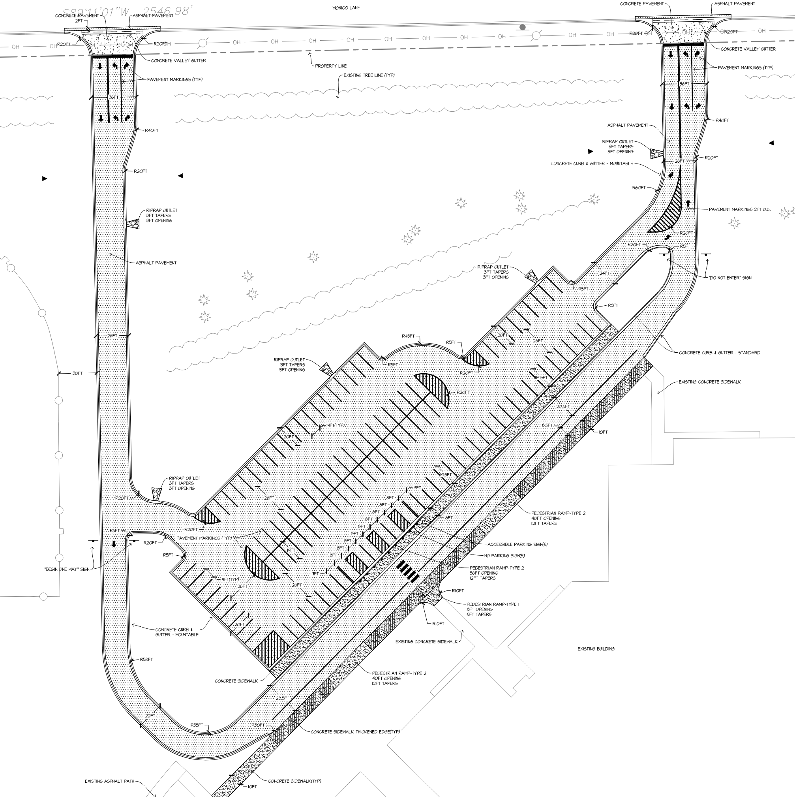
Plan Review

Slide 5
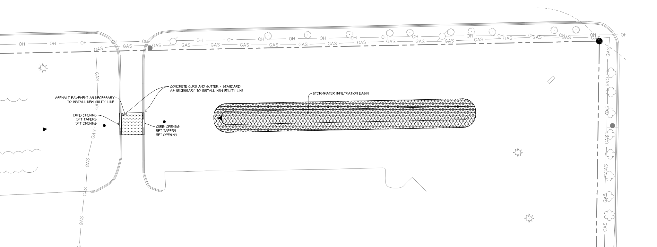
Plan Review

Slide 6
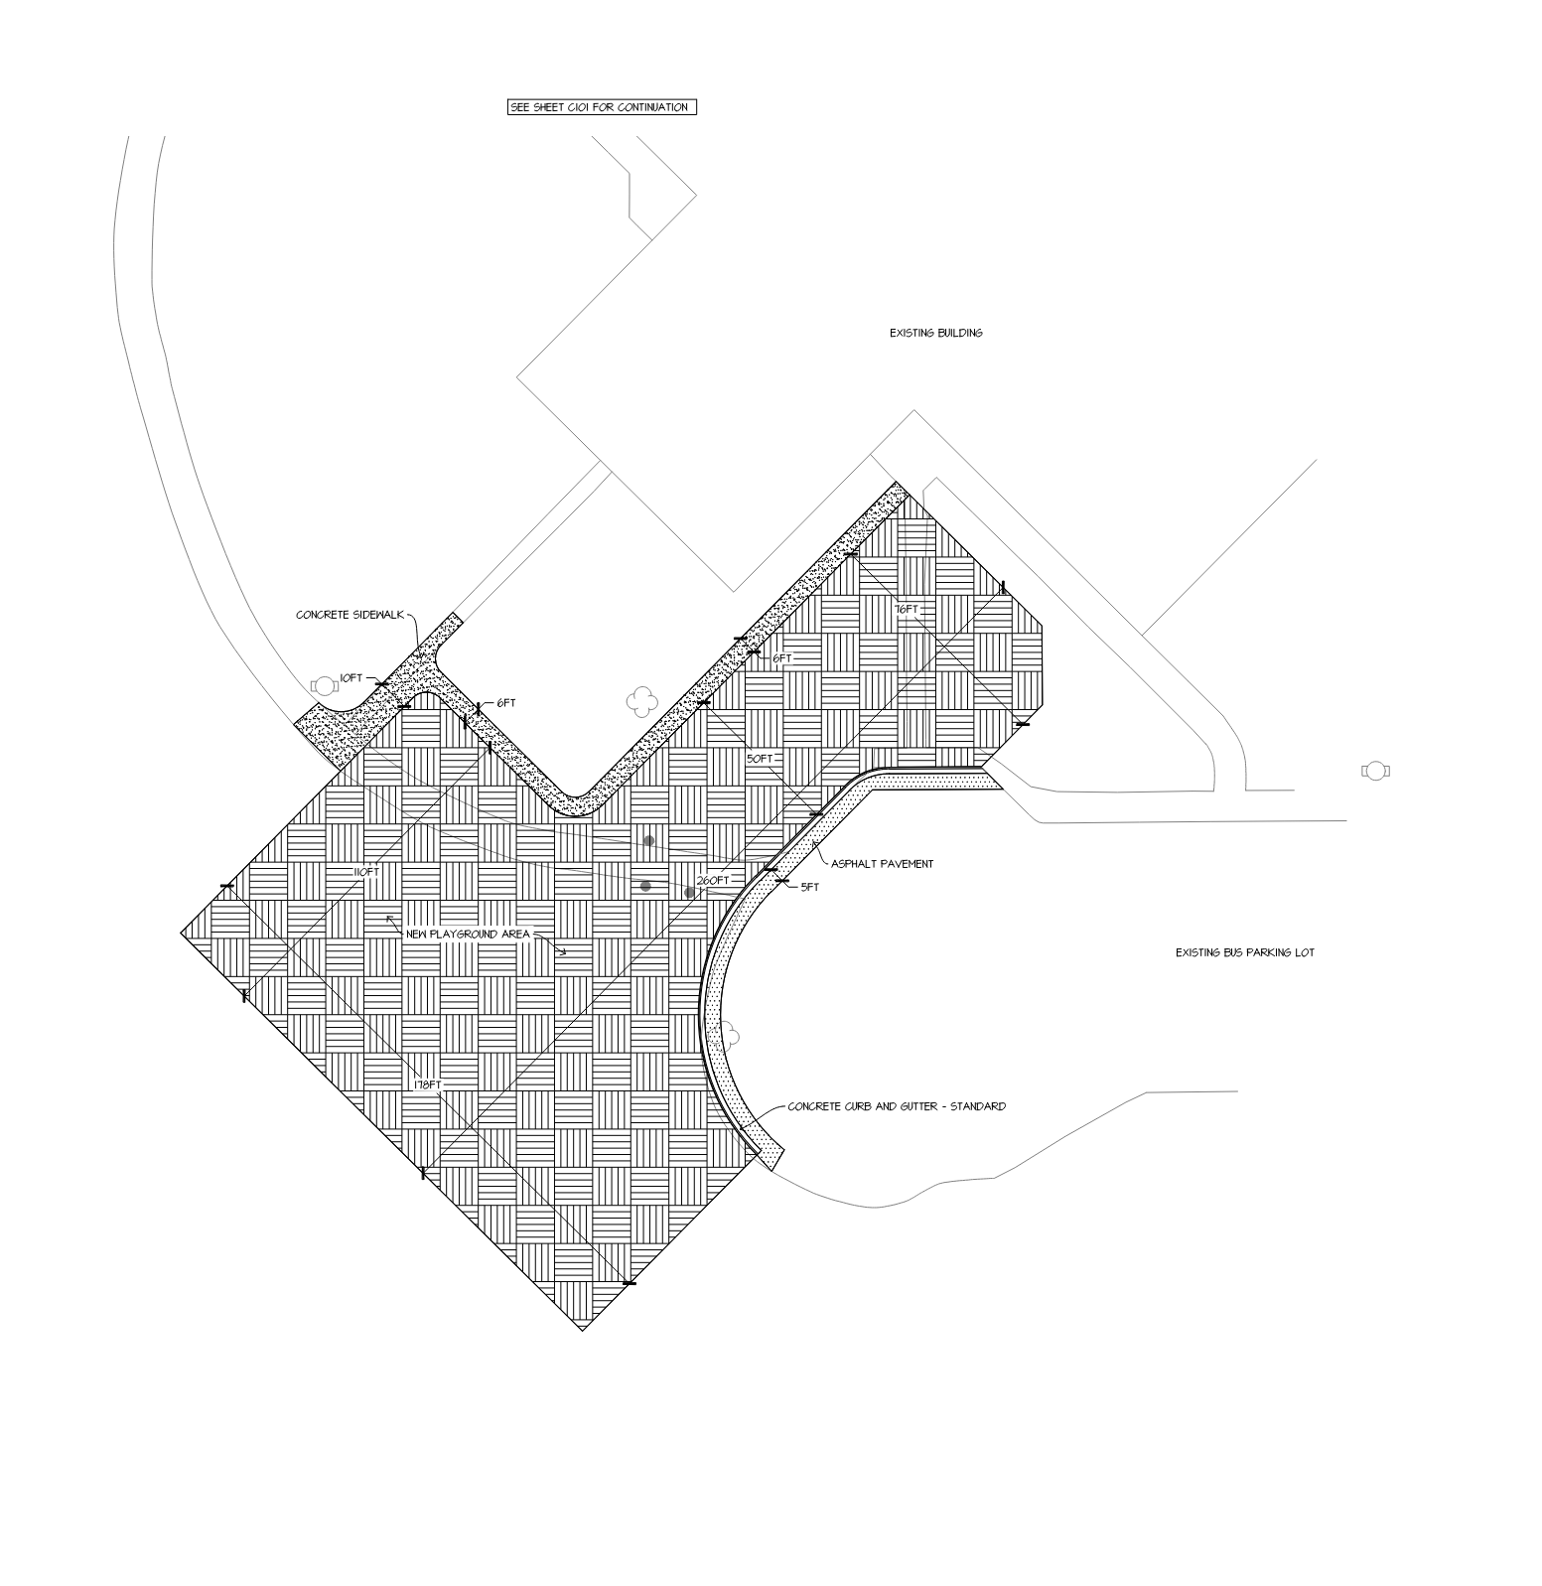
Plan Review

Slide 7
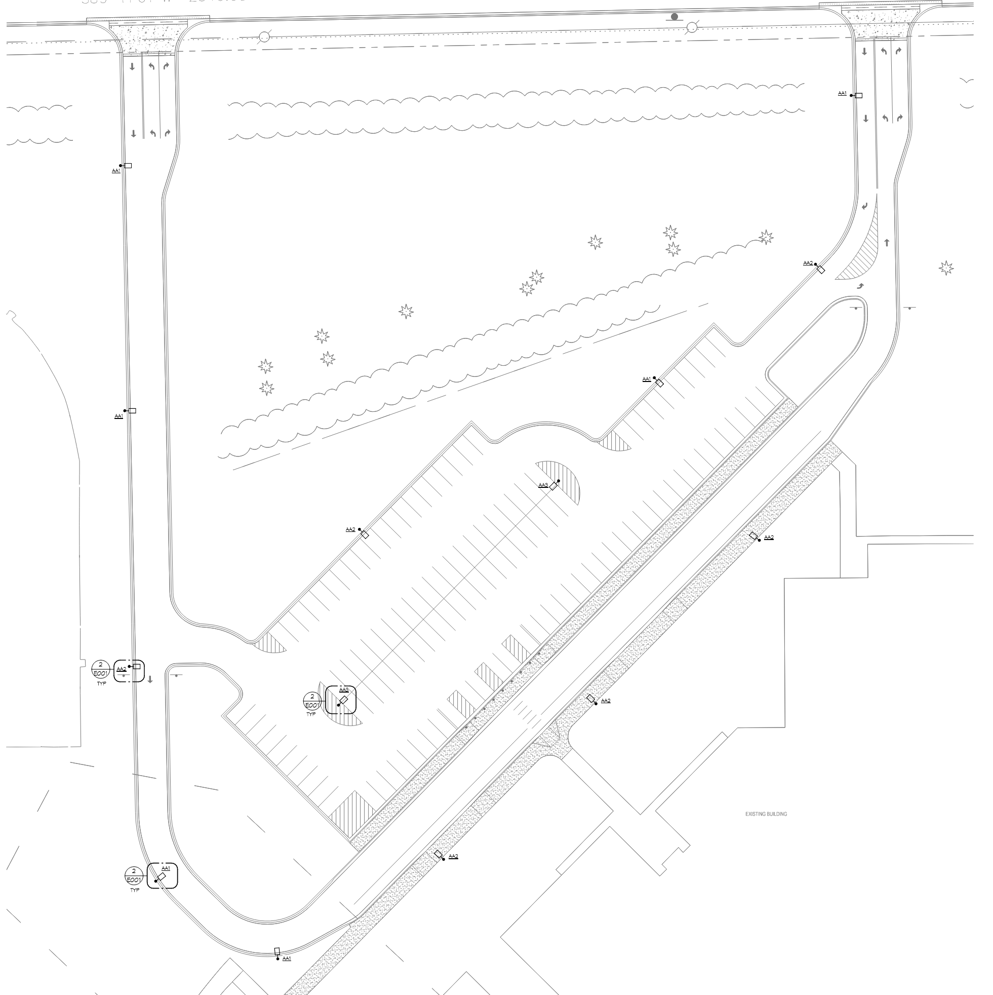
Plan Review

Slide 8
Secondary Design Development - Schedule
Task Name | Duration | Start | Finish
Century Site Improvements | 469 days | Tue 11/2/21 | Fri 8/18/23
Preconstruction | 16 days | Tue 11/2/21 | Tue 11/23/21
Schematic Design | 100 days | Tue 11/2/21 | Mon 3/21/22
Design Development | 129 days | Tue 3/22/22 | Mon 9/19/22
User Group #1 - Elementary Parking | 1 day | Tue 4/12/22 | Tue 4/12/22
Design Development Process | 115 days | Tue 3/22/22 | Mon 8/29/22
ICS Budget / Schedule Preparation | 5 days | Tue 8/30/22 | Mon 9/5/22
DD Board Approval | 0 days | Mon 9/19/22 | Mon 9/19/22
Construction Documents | 249 days | Tue 9/6/22 | Fri 8/18/23
Construction Documents Process | 75 days | Tue 9/6/22 | Mon 12/19/22
ICS Budget / Schedule Preparation | 10 days | Tue 12/20/22 | Mon 1/2/23
CD Board Approval | 0 days | Mon 1/2/23 | Mon 1/2/23
Bid Procurement | 26 days | Tue 1/3/23 | Tue 2/7/23
Bid Opening | 0 days | Tue 2/7/23 | Tue 2/7/23
Plumbing Plan Review | 30 days | Tue 1/3/23 | Mon 2/13/23
Critical Submittals | 20 days | Wed 2/8/23 | Tue 3/7/23
Contract Procurement | 30 days | Wed 2/8/23 | Tue 3/21/23
Construction | 55 days | Mon 6/5/23 | Fri 8/18/23
Park Rapids Additions and Renovations

Slide 9
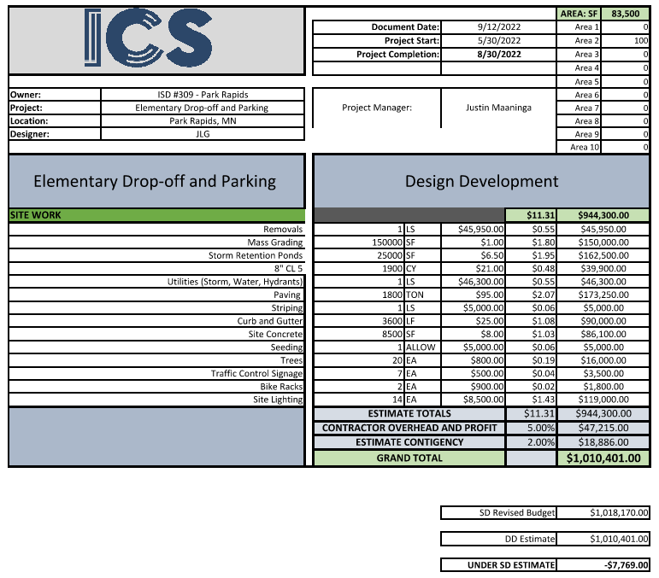
Estimate

Slide 10
Secondary Design Development
We Recommend to Approve the Century Site Improvements Design Development
Submission as Presented with the Authorization to Proceed with Construction
Documents
Park Rapids Additions and Renovations

Slide 11
Questions?

