Slide 1
Board Update
High School – BP #1 Precast – Approval to Receive Bids
September 6th, 2022
Park Rapids Additions and Renovations
PARK RAPIDS PUBLIC SCHOOLS

Slide 2
What’s Been Done?
Approx. 50% Complete with Construction Documents at Secondary
Prepared Bid-Pack #1 Precast
Tennis Courts are Substantially Complete
Metal Panel Refinish Project
Nearing completion
Progress on the Bus Garage Design
Identified the “Foot Print”
Have held and will continue to hold, User Group Meetings
Working on Playground Design
Park Rapids Additions and Renovations

Slide 3
What’s Been Done? (continued)
Weekly Design Coordination Meetings
Coordination meetings with all design disciplines
Presented to Staff
Design Status
Anticipated Schedule
Park Rapids Additions and Renovations

Slide 4
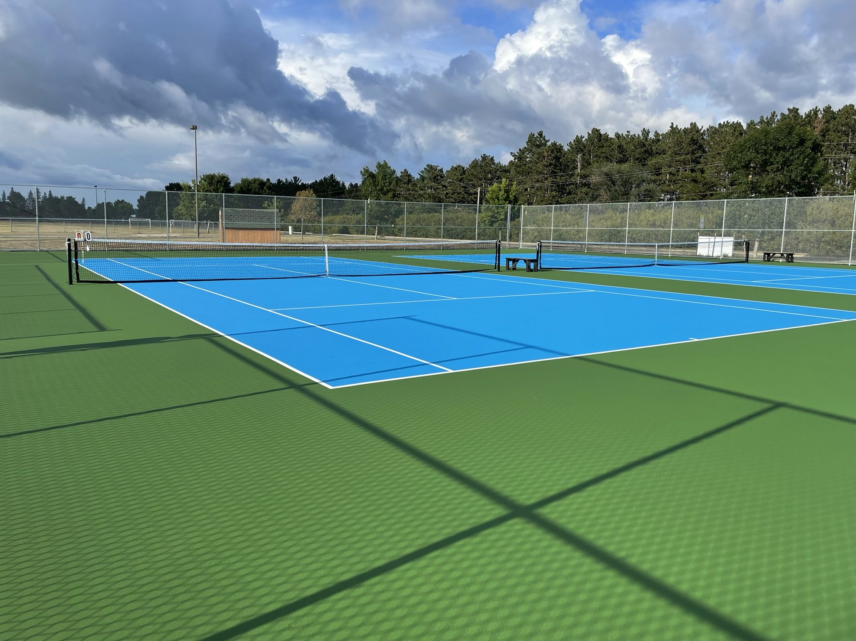
Tennis Court Pictures

Slide 5
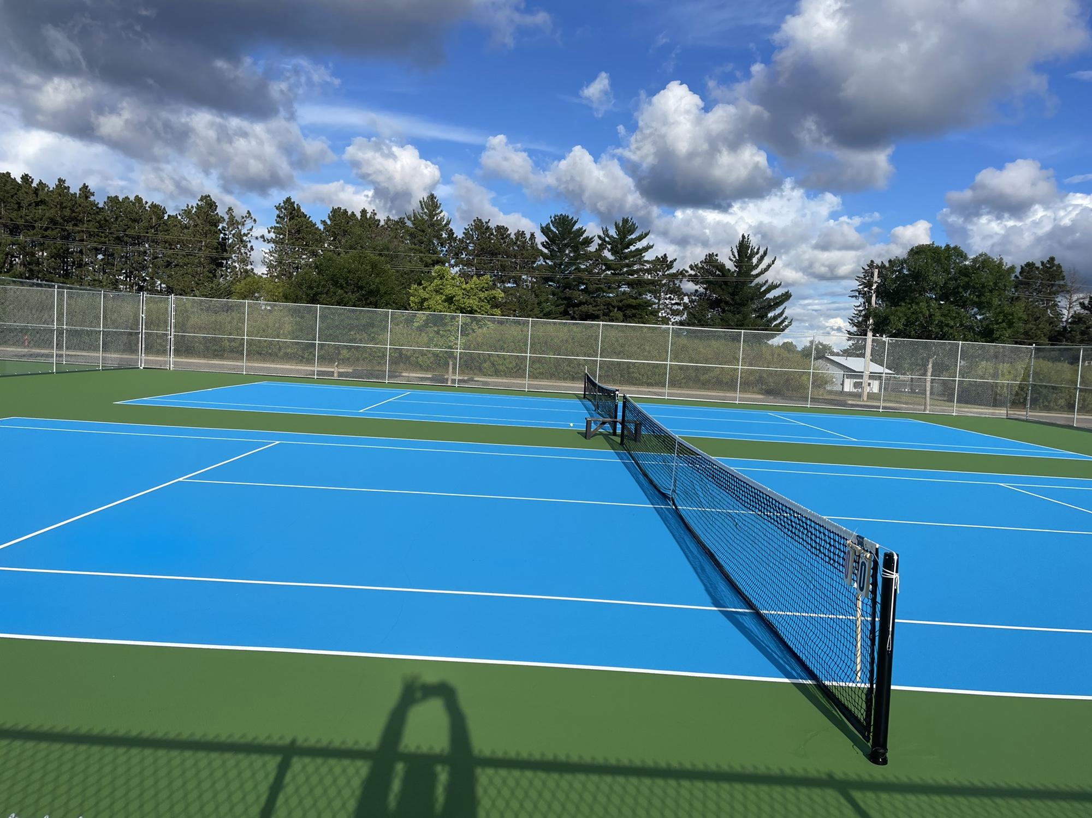
Tennis Court Pictures

Slide 6
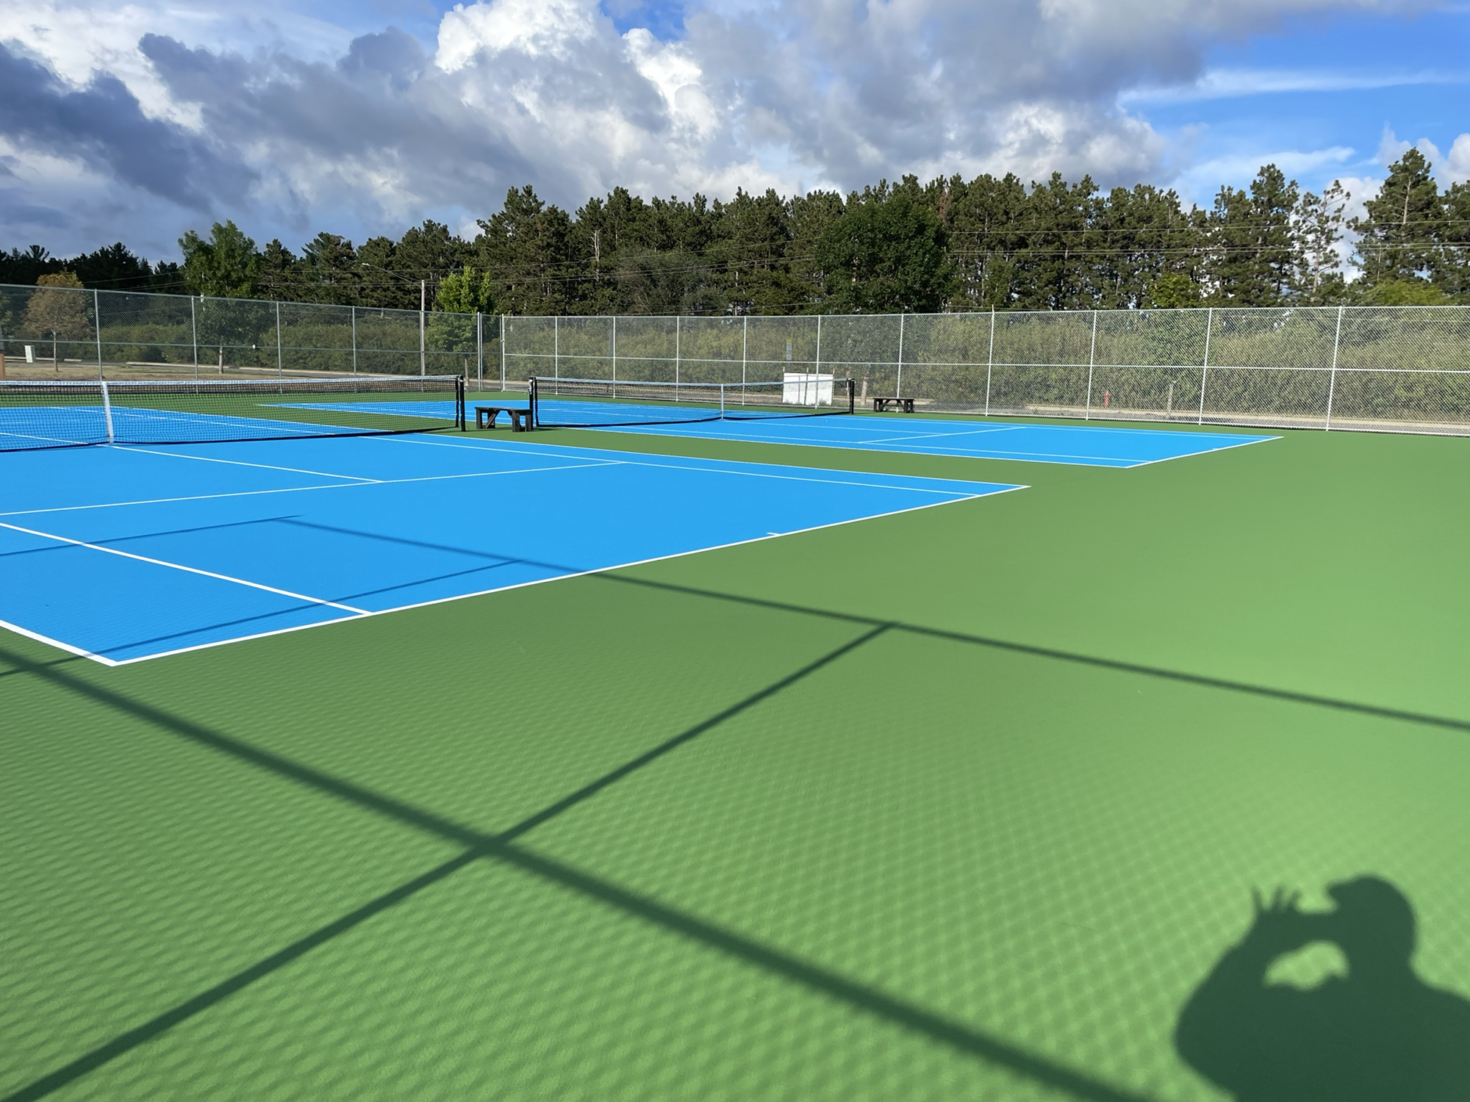
Tennis Court Pictures

Slide 7
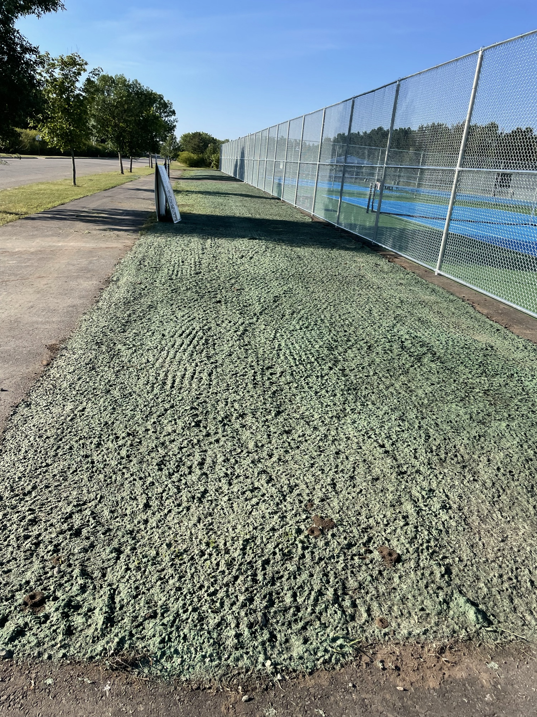
Tennis Court Pictures

Slide 8
Upcoming
Continue with Construction Documents at Secondary
CD Completion (Design), December 5th
Complete the Tennis Court Punchlist
Century Parent Pick-up / Drop-off Design
Working on DD Estimate
Bus Garage Design
DD’s Complete, End of October
Playground Design
Intent is to have installed next summer in conjunction with the Parent Pick-up
drop-off project
Park Rapids Additions and Renovations

Slide 9
Preliminary Overall Schedule – Subject to Change
Tennis Courts – Summer of ‘22
Bus Garage – Summer of ‘23
Elementary Parent Pick-up / Drop-off – Summer of ‘23
Elementary Renovations – Summer of ‘24
Frank White Demolition – May/June of ‘23
Secondary Additions – Commence Summer of ‘23 – Complete August of ’24
Secondary Additions (ALC/Trans./Kitchen) – Commence Summer of ‘24 and – Complete
May of ’25 (Reference Phasing Plan)
Secondary Phase 1 Renovations – Summer of ’24 (Reference Phasing Plan)
Secondary Phase 2 Renovations – Summer of ’25 (Reference Phasing Plan)
Park Rapids Additions and Renovations

Slide 10
Bid Package #1 - Precast
Architectural Precast Wall Panels are scheduled for the Gym
Estimated Valuation, Supply and Install, $810,000
Approximately a 1 yr Lead Time
To conform to the Construction Schedule, this early Bid Package is necessary
Intending on Opening Bids, September 20th, 2022
Park Rapids Additions and Renovations

Slide 11
Bid Package #1 - Precast
We recommend approval to procure Architectural Precast bids, Bid Package
#1 – Precast, as presented.
Park Rapids Additions and Renovations

Slide 12
Questions?

